Slide 1


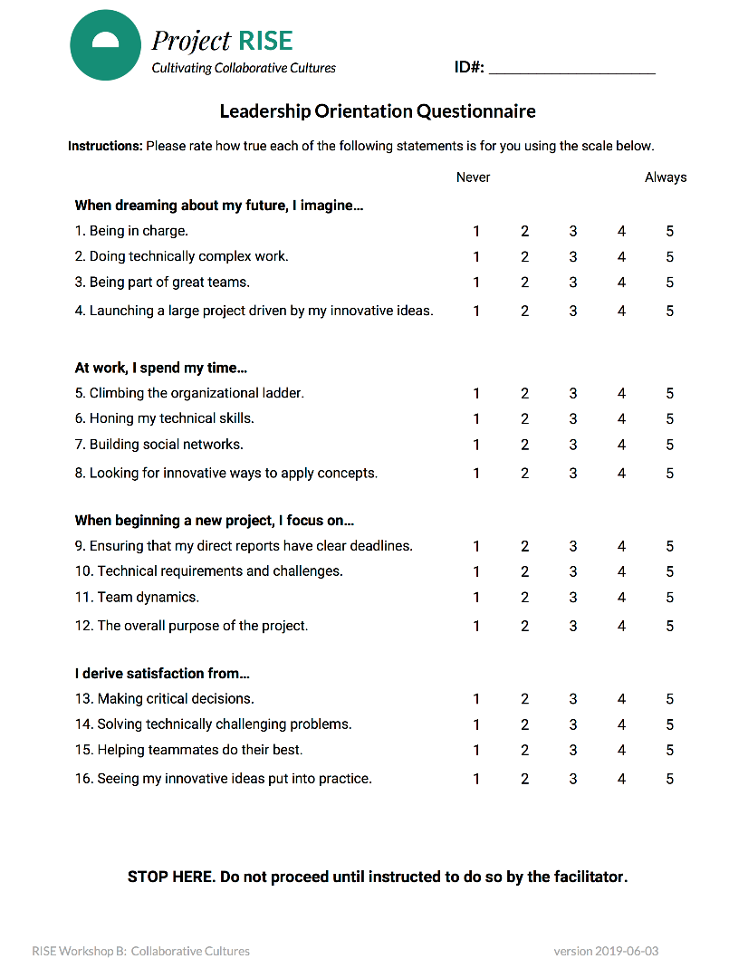
Leadership Orientation Survey
If you haven’t already done so, please complete the Leadership Orientation Questionnaire before we begin.
Notes:
[RISE EXPERT STARTS OFF AFTER BREAK]
We are about to head into our break, but before we do, please complete the leadership survey included in your envelope as we’ll be talking about this after we start back up.

Slide 2





ORG/SITE-SPECIFIC
Place, date
Cultivating Collaborative Cultures
INFLUENTIAL LEADERS
Notes:
Video with Toni’s narration (https://embed.vidyard.com/share/y3TTdeMrJJBGFhnb9q8HBT?)

Slide 3

How and why we lead
What is a leader?
-- Break
3) STEM and leader identities
Putting leadership into action
-- 1 p.m. lunch
ORG/SITE-SPECIFIC
Timing
Influential Leaders
Notes:
Welcome back from the break.
In the second half of the session here today, we're going to be talking more specifically about how those of us in STEM think about our identities as leaders and how research points to three specific leadership strategies that might be most conducive for STEM professionals’ success.
Then we're going to talk about how to put everything we've learned today into action.

Slide 4

03.1
STEM and
Leader Identities
Notes:
Now up to this point we've talk about leadership traits and skills more generally, but research carried out by the University of Toronto's I-LEAD team suggests that people working in STEM fields often find it challenging to think about themselves as leaders.

Slide 5
STEM Identities
Leader Identities
Applied scientist
Service professional
Team player
Technical problem solver
Task-oriented doer
Process optimizer
Charismatic visionary
Hierarchical influence
Agentic individual
Solves people problems
Delegator
Change agent
Rottmann, Sacks, & Reeve, 2015
Notes:
Sometimes people can feel their identities as engineers or scientists are distinct from what they think it means to be a leader.
When we think about what it means to be in STEM, we might think of ourselves as an applied scientist or an engineer, as being a team player working together to solve technical problems, as trying to optimize processes, being a task-oriented doer.
When we think about a leader and what kind of identity they need to have, we might think about this sort of charismatic visionary who has hierarchical influence, that’s designed to solve people problems, to delegate, and to be an agent for change.

Slide 6
Yet STEM Professionals Do Have Influence
For example:
Model technical excellence & pass on experiential insights through mentorship
Bridging organizational units to integrate team members’ strengths
Drive growth and innovation by defining creative, technically feasible visions
Language on this slide could be more accessible. I found myself paraphrasing it and generally tried to go through these slides very quickly.
Notes:
Once we recognize that leadership just means influencing people toward goals, it might be easier to see the way that as STEM professionals, you already do have influence.
Because of that, all of us have the ability to be leaders.
So for example, leaders can be anybody who models their technical expertise for others and tries to pass on their experience and insights through mentorship.
It can be anybody who tries to build bridges across organizational units by capitalizing on the strengths of different people.
It can be anybody who tries to drive growth and innovation by defining creative, technically feasible visions.

Slide 7
STEM Identities
Leader Identities
Applied scientist
Service professional
Team player
Technical problem solver
Task-oriented doer
Process optimizer
Charismatic visionary
Hierarchical influence
Agentic individual
Solves people problems
Delegator
Change agent
STEM Leader
Rottmann, Sacks, & Reeve, 2015
Notes:
Research from Rottman and colleagues from the University of Toronto reveals that there's actually overlap between these identities once we think about leaders as having influence.

Slide 8
Merging STEM Identity and Leader Identity
Question Set 5
With your partner, take turns answering both questions for 5 min.
How do STEM professionals lead through influence?
Describe someone in your field who has a positive influence on you.
Notes:
So before we go any farther, to set the stage for what we'll talk about, I'm going to have you have another conversation with your pair.
So this is question set 5 in your booklet and I want you to spend some time talking about how STEM professionals in particular lead through influence.
So what are the ways in which you see leadership in STEM as being unique?
And then describe someone in your field whose had a positive influence on you and think about what that person does to be influential.
Okay, so welcome back from that discussion.

Slide 9

STEM professionals can find it difficult to identify as leaders
Challenge is to re-frame leadership…
  as having impact and influence
  as skills and strategies to be learned
Notes:
We're going to summarize just this brief section by saying that STEM professionals sometimes find it difficult to identify as leaders.
But the challenge is to reframe what leadership is.
It mainly means having impact and influence over other people.
And again, tying back to what we talked about before the break, we're going to talk about leadership as skills and strategies that we can learn.

Slide 10

03.2
Leadership Strategies
Notes:
Let's say more about what those skills and strategies are.
And I want to go back to the design task that you all did at the very beginning of today's session

Slide 11

Design Task: Who Was Most Successful?
What role did the leader play in facilitating the process?
Notes:
Let’s go back to the design challenge we had the start of the morning:
The winning tower was [indicate table]:
First, let's just take a minute to reward the team with the winning tower. And we do have a prize here for the team at table X. Great.
You might recall that each of the leaders for your groups were actually given different instructions for how to lead.
So in this next section we're going to be going into detail about four different leadership strategies.
Leaders, you might be able to guess which role you were given based on the information that I'm going to be describing, but I want you to keep that information to yourself right now while we go through this content.
As we talk about these different strategies, let's see if others at the table are able to guess which strategy you were given based on what they observed.
And importantly, I want to first just thank you for playing along.
Please give a hand for all of our leaders who led us through this task.

Slide 12



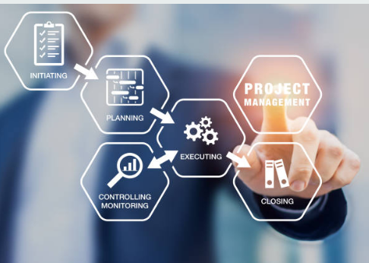
Four Strategies for Leadership in STEM Organizations
Autocratic
Direction
(delegation
+ structure)
Technical
Mastery
(technical expertise
+ mentorship)
Collaborative
Optimization
(process optimization
+ team catalyst)
Organizational
Innovation
(innovation
+ realization)
Predicts having more nimble and innovative solutions
Rottmann, Sacks, & Reeve, 2015; see also Ancona, Backman, & Isaacs, 2019; Borgmann et al., 2016; Hartnell et al., 2019; Yukl et al., 2002
Notes:
We're going to talk about four distinct leadership strategies.
Briefly, we will be referring to these as autocratic direction, technical mastery, collaborative optimization, and organizational innovation.
The three strategies here on the right are strategies that have been specifically identified by the I-LEAD group as key strategies to leadership that might be particularly effective in science and technology settings.
They also map onto three similar strategies identified by researchers at MIT as being essential to ‘nimble leadership’ – the ability for a company to be flexibly innovative over time.
But even more broadly than STEM, three similar kinds of leadership strategies have long been recognized as key way to think about different approaches to leading others.
And in a recent meta-analysis, these forms of leadership taken together were a strong predictor of innovation.
We can contrast these against autocratic direction, which is the more traditional form of direct leadership that we tend to first associate with leaders.
Again, as I walk you through definitions of each of these in the following slides, I want you to think about which one of these four strategies might best describe the leadership strategy that was used in your design team.
But don't say anything for now because afterwards I'll give you the chance to discuss it as a group and come to a consensus.

Slide 13
Autocratic Direction
Leads by exerting authority
  Focus on performance, timelines
  Imposes procedures and standards
  Does not seek input or suggestions
Key skills to exhibit
  Initiating structure
  Providing directions and demands
  Imposing rewards and penalties
De Hoogh et al., 2009, 2015; Van Vugt et al., 2004
Notes:
So let's talk about the first, autocratic direction.
Autocratic direction means to exert authority over others.
It's sometimes what we think of when we think of the more traditional and hierarchical notion of leadership.
An autocratic director focuses on performance and timelines, and how to get things done according to procedures and standards.
Autocratic directors don't necessarily seek out input or suggestions.
The key skills exhibited here including being able to initiate structure, providing clear directions on demands on what to do and then imposing rewards and penalties for good and bad performance.

Slide 14

Technical Mastery
Leads with technical expertise
  Subject matter specialist
  Can explain complex problems
  Develops creative solutions
Key skills to exhibit
  Confidence to initiate one’s ideas
  Take action to serve broader goals
  Attract others to join the project
Notes:
Now let's talk about 3 other strategies.
First, technical mastery is a task-focused style of leadership that entails having influence because of one’s technical expertise.
Leaders who exhibit this strategy are often subject matter specialists who have the ability to explain complex problems to others and develop creative solutions to technical challenges.
If you want to become more of a technical master, the key skills to develop including having the confidence to initiate or advocate for your own ideas, to take action to do things that can serve the broader goals of the team or organization, and to attract others to join in and collaborate with you on projects because of your know-how.
Technical masters are influential because they know how to get things done and are willing to share their skills with others and for the good of the team or organization.

Slide 15
Collaborative Optimization
Leads with process optimization
  Interdisciplinary approach
  Leverages team members’ strengths
  Inspires and motivates members
Key skills to exhibit
  Asking questions to guide and mentor
  Connecting people to foster innovation
  Sharing information across units
Notes:
The next type of strategy we'll talk about is collaborative optimization.
People who use this more connection-focused strategy lead by looking for ways to optimize processes to get the most out of everyone.
They're likely to take a more interdisciplinary approach, and are skilled at leveraging people’s strengths to match certain project objectives.
By doing this, they also inspire and motivate people to do their best.
If you are looking to become better at collaborative optimization, you might focus on learning how to listen to others and ask questions that can put you in a position to guide and mentor them.
You would also practice how you can connect people together to foster innovation and to develop procedures that encourage sharing information across units.
Collaborative optimizers are influential because they optimize people’s ability to collaborate effectively.

Slide 16

Organizational Innovation
Leads with innovation
  Has field-wide knowledge
  Outside-the-box thinking
  Takes calculated risks and learns from mistakes
Key skills to exhibit
  Growth mindset for the organization
  Remain curious to new ideas
  Seek out critique
Notes:
The final strategy here is organizational innovation.
This is what organizational researchers say is a strategy focused on change and flexibility.
When we lead with organizational innovation, we tend to have broader field-wide knowledge, we try to engage in outside the box thinking, and we're willing to take calculated risks and learn from our mistakes.
If you are hoping to become more of an organizational innovator, you want to develop a growth mindset for your team or organization, to remain curious to new ideas, and to seek out critique.
Organizational innovators have influence by having a vision for the future, making an impact on the way projects are going, and attracting new resources to get there.

Slide 17
Design Task: What Type of Leader Did You Have?
Leaders, stay quiet while the group discusses which strategy was assigned (3 min)
Leader shares his/her perspective and how it felt to carry out that strategy (2 min)
3) Groups share their experiences with the room (5 min)
Autocratic
Direction
(delegation
+ structure)
Technical
Mastery
(technical expertise
+ mentorship)
Collaborative
Optimization
(process optimization
+ team catalyst)
Organizational
Innovation
(innovation
+ realization)
Notes:
So now I've laid out these four different kinds of leadership strategies: autocratic direction, technical mastery, collaborative optimization, organizational innovation.
Which type of leader do you think you had?
So for ten minutes or so, you will have a discussion at your table.
For the first few minutes, I want the leaders of your tables to stay quiet while the group tries to guess which strategy had been assigned.
And then when you reach consensus, maybe the leader can share his or her perspective about how it felt to carry out this strategy.
And you can talk about whether or not it was communicated effectively.
And then we're going to come back and we're going to share this information with the room at large. [pause]
Okay, so now that we're back, I'm just curious to hear.
So how many people feel like they have a good sense of which strategy they were given? [pause] Okay.
If you turn over your leadership cards, or even go back to consult them you might see clues, and actually the initials for these strategies are given on the back of your cards so you'll be able to tell.
All right, so out of curiosity, for the person who had autocratic direction, what/how did you try to communicate that to your team? [pause] Okay.
And how about the team that used technical mastery? [pause] Okay.
And what about the team that used collaborative optimization? [pause] Okay.
And what about the team that used organizational innovation? [pause] Okay.
In what ways was it sort of difficult to convey this leadership strategy in this task?
So this is a very specific kind of task and not all of these strategies maybe are as conducive to building towers out of paper, but we can probably imagine how these strategies could be useful in other kinds of situations.
Give them 10 [5?] minutes for discussion with 5 minutes to summarize to the room.
Took 10.5 min to get to this discussion (10 min allotted)

Slide 18
Benefits and Costs of Different Strategies
Autocratic
Direction
Technical
Mastery
Collaborative
Optimization
Organizational
Innovation
Benefits: High performance (if respected)
Can work well in urgent situations
Costs: Team burnout, low satisfaction
  Less input risks groupthink
Benefits: Provides a balance of freedom and control
Can foster continuous innovation
Costs: Coordination can be complicated
Takes time to socialize new members
Organizational changes meet resistance
Notes:
These different types of strategies can of course have different costs and benefits.
Autocratic direction can lead to success, especially under time pressures.
But this assumes that team members respect the leader.
Key downsides are that this kind of top-down control can lead to team burnout and dissatisfaction, and as we talked about earlier, can also promote groupthink.
These other three forms of leadership, in contrast, provide a balance of freedom within teams but also control from those with influence.
Research has shown that companies that foster these kinds of leadership strategies are better able to continually innovate and adapt to change.
But this kind of flexible coordination within teams can be complicated and it can take some time to socialize new people to more informal patterns of leadership and influence.
Once this kind of culture is established, people who’ve grown accustomed to this more flexible style of leadership might find big organizational changes difficult.

Slide 19

How do we measure leadership strategies?
Notes:
And not surprisingly, there are ways that we can measure these leadership strategies.
So let’s take a closer look at the measure we completed right before the break.

Slide 20
What Is Your Primary Leadership Strategy?
1
Have you completed the Leadership Orientation Questionnaire?
Scoring your strategies by adding up ratings to items:
2
Autocratic
Direction
Technical
Mastery
Collaborative
Optimization
Organizational
Innovation
=
1 + 5 + 9 + 13
=
2 + 6 + 10 + 14
=
3 + 7 + 11 + 15
=
4 + 8 + 12 + 16
=
Rottmann, Sacks, & Reeve, 2015
Notes:
Please take out your leadership orientation survey.
I'll walk you through how you can self-score this survey.
So what I'll have you do is to, on the back side of this sheet you can see that there's a place to add up the numbers of the ratings that you gave to questions on the front side.
Your autocratic direction score comes from the rating you gave to the first item in each of the four blocks of questions 1, 5 , 9 and 13.
Technical mastery is adding up the scores you gave to the second question in each block, so items 2, 6, 10 and 14.
Collaborative optimization is adding up 3, 7, 11 and 15.
And organizational innovation the fourth item in each of those sets.
So I'll give you a few minutes to add up your scores.
Please look up at me when you’re ready to continue. [pause]
Okay. So this survey gives you a bit of an idea of what your primary leadership strategy is likely to be, the one that's the default way you like to lead.
And later we'll talk about identifying one of these strategies that's more of a growth strategy. One that you would like to get better at.
But I want to make the important point that all of these strategies can be beneficial, so it might be best to think of them as tools that you can have in your toolbox.
Some might be areas you've already developed, and some might be areas for growth.

Slide 21


Rethinking Leadership in STEM
Autocratic direction is geared
toward formal leadership by compliance
Everyday leadership
by commitment is
better achieved via:
Technical
Mastery
Collaborative
Optimization
Organizational
Innovation
Notes:
Earlier we talked about the distinction between leading by compliance and leading by commitment.
So if autocratic direction is the only strategy that you're using, then it might be more of an attempt to merely lead by compliance, using that more traditional top-down form of leadership.
For the rest of the session we're going to focus more on these other three types of leadership by commitment strategies: technical mastery, collaborative optimization and organizational innovation.

Slide 22
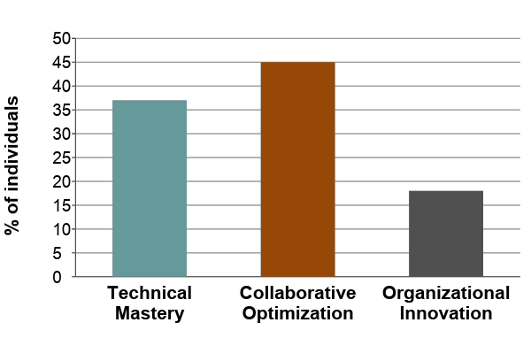
Distribution of Leadership Orientations
Rottmann, Sacks, & Reeve, 2015
Notes:
The I-LEAD team has collected data with STEM professionals on these 3 types of leadership orientation.
And they find that about 45% of people see themselves as most commonly using the collaborative optimization strategy.
Another 36% or so used technical mastery, and about 17% or 18% used organizational innovation.
But these strategies also seem to change in their preferred status over the course of one's career
(N = 175)

Slide 23
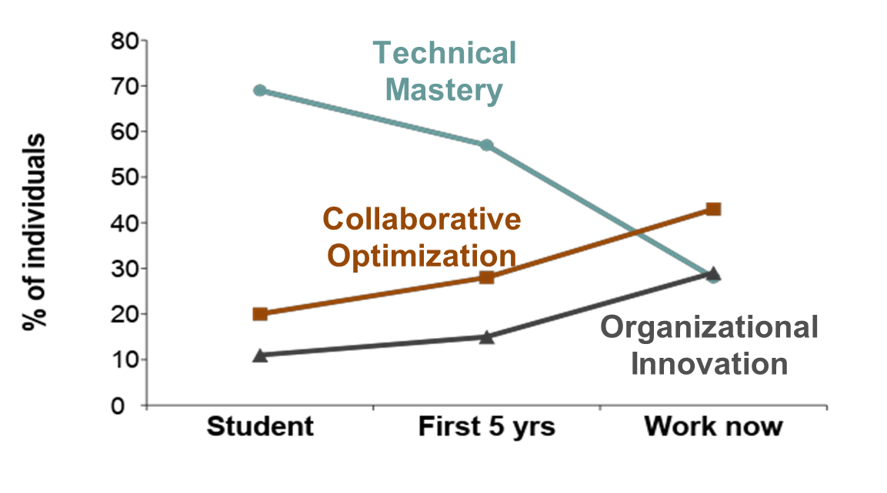
Non-Technical Leadership Grows Over Time
Rottmann, Sacks, & Reeve, 2015
Notes:
So, early in your career, especially as a student or in your first 5 years in an organization, you might be really focused on getting the technical skills and know-how and maybe seeing how to share those with others.
But over time you can see people become more comfortable as collaborative optimizers or organizational innovators.
So through experience you can think about how you might be developing these skills over time.

Slide 24

Brainstorming Examples of Influence
Write concrete actions on colour-coded note cards (3 min) & discuss at your table (7 min)
Technical Mastery
  Think of who you seek out for their technical expertise.
  Write down a specific action of theirs that influences others.
Collaborative Optimization
  Think of who builds high performing teams by bringing out the best in others.
  Write down a specific action of theirs that influences others.
Organizational Innovation
  Think of whose creative ideas drive projects forward.
  Write down a specific action of theirs that influences others.
Notes:
So next what I'd like you to do, now that you've learned a little bit about these 3 commitment strategies, is to brainstorm some examples of these kinds of influence.
You'll see there are note cards in the middle of your table and what I'm going to have you do is write concrete actions on these color coded note cards that you can then discuss at your table.
I want you to think about people who you know who exemplify each type of leadership strategy.
It might be someone who came into mind for one of the earlier conversations that you had or it may be someone completely different.
It doesn't have to be someone at this organizations it could be someone from your education, from another company you've worked for, or in some other form of life.
Now let me just make myself clear you don't need to write the name of the person it's more about sourcing specific types of strategies that use specific actions that you see these role models of leadership taking.
First, I want you to think about the person who you seek out for their technical expertise, and then on the blue card I want you to write down a specific action of theirs that influences others.
Second, for collaborative optimization I want you to think about someone who builds high-performing teams by bringing out the best in others, and I want you to write down the specific action that they take to influence others on yellow cards.
Third, for organizational innovation, I want you to think of someone whose creative ideas really drive projects forward and I want you to write down a specific action of theirs that influences others and do that on a purple card.
Now again, you can also write down actions that you yourself use that you think are especially beneficial or effective for each of these three types as well.
But I want you to take 3 minutes to write down some ideas and then spend 7 minutes actually discussing what you wrote.
Took 7 minutes to get to the beginning of this (6 allotted but ok)

Slide 25

Core Competencies of Leadership Strategies
Technical Mastery
Collaborative Optimization
Organizational Innovation
Holding workshops on new technical skills
Giving advice on others’ work problems
Demonstrate knowledge
Be a sounding board
Explain things clearly
Be approachable, open to being challenged
Ask relevant, thought-provoking questions to help develop others’ capacity
Stay on top of new developments
Connect people to other resources
Connecting people with complementary skills
Resolving conflicts on the team
Organize working groups around a common problem
Assemble a group to discuss an issue directly
Acknowledge you don’t know everything
Appreciate input from all team members
Pitching new ideas
Moderating a discussion on big-picture thinking
Communicate the current big-picture problem effectively
Reference your broad range of experiences and exposures
Understand your audience to create buy-in
Be a champion for a concept, clear the way for others
Have authentic belief in what you’re championing
Connect to underlying goals and principles
Have perseverance and resilience in the face of resistance
Notes:
Okay, so now that you've had a chance to source some ideas and collectively talk about them, maybe you can tell me about them and we can add them to this list.
Really what we're trying to source here are core competencies for leadership strategies. So technical mastery, does anyone have any good examples of specific actions that someone uses to show technical mastery.
Great, and how about collaborative optimization, can I have a few good examples of collaborative optimization?
And then how about organizational innovation?
You’re welcome to take a picture of this slide to retain ideas of actions of each type that you can take.
Use this slide to highlight some of the specific concrete examples the groups generate for 5 min. Have WinSETT facilitator come up and type up suggestions from the room on the slide. At the end, encourage them to take a picture of the slide to have ideas of actions they can take of each type.

Slide 26
We can lead through compliance or commitment
  Autocratic direction is leading through compliance
Three strategies to lead by commitment:
  Technical Mastery
  Collaborative Optimization
  Organizational Innovation
Leadership does not require a formal leadership role
Notes:
To summarize this section, I've talked about how we can think about leadership through compliance or how we can think about leadership through commitment.
And autocratic direction, getting things done, being very task focused, can be a useful strategy to use some of the time but if that's the only way that you are leading exclusively then it really is leading primarily through compliance.
So we've tried to open up and broaden our idea of leadership by thinking about these other strategies. To lead by commitment through technical mastery, collaborative optimization, and organizational innovation.
And a broader point we are trying to make here is that leadership doesn't require a formal leadership role; we can all be everyday leaders by enacting any one of these behaviours in our organization.

Slide 27
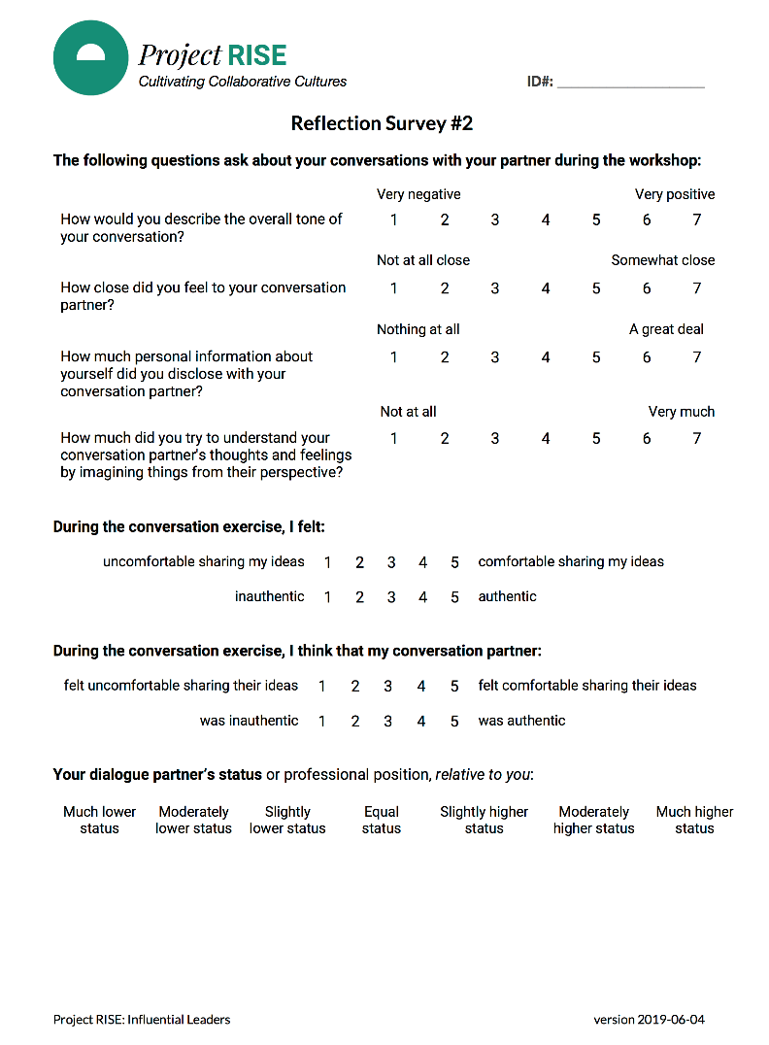
Reflection Survey #2
Please take 3 minutes to complete Reflection Survey #2
Notes:
So now before we move on to the last segment of today’s section I want you to take a few minutes to complete the reflection survey.
Reflection survey 2 that's in your folder, please just fill this out.
Again these data are really important to what we're trying to assess here.
And once you've filled it out just put it back into your folder.

Slide 28
HAND OFF FROM RISE TO WINSETT

Slide 29
How and why we lead
What is a leader?
-- Break
3) STEM and leader identities
Putting leadership into action
-- 1 p.m. lunch
ORG/SITE-SPECIFIC
Timing
Influential Leaders
Notes:
Okay, so here we are home stretch ready to talk about taking all of this fantastic information that Hilary/Toni has shared with us and putting it into action.
So we're going to leave here with some really tangible ideas and one specific commitment that you're going to make in order to make yourself a more effective leader.
That sound good?

Slide 30

04
Putting
Leadership
Into Action

Slide 31

Becoming a Better Leader by
Drawing on the Science of Goal Pursuit
When to act?
Identify the specific cue
What to do?
Make it achievable
What might stop me?
Plan to overcome obstacles
Gollwitzer, 1999; Oettingen, 2000; Wood, 2017
Notes:
[Note, the animation order here is a conscious attempt to start in the middle with the action]
To do this, we're going to leverage what we know about the science of goal pursuit.
In other words, how do we take something that we want to achieve, like becoming a better leader, and make it happen?
First, we start with knowing what we're going to do.
Obviously, we want to plan to do something that is feasible and realistic, to make it more likely that we will actually implement it.
Here, you might be familiar with the acronym SMART: you want to focus areas of change on something that is Specific, Measurable, Attainable, Realistic, and Timely.
The second thing we want to do is identify the cue that will remind when it's time to act.
We want to focus on something specific that we are likely to encounter so that this can serve as a reminder of our goal.
Finally, we want to anticipate some of the obstacles that could get in our way, so that we can put a plan in place to combat those obstacles.
For example, this morning we spoke about reasons we might shy away from becoming a leader.
We’re going to talk a little more specifically about some of the ways these obstacles might come up and make a plan to overcome them.
So that is the big picture of what we’re going to do over the next hour.

Slide 32
Which is Your Primary Strategy?
Identify a Growth Strategy to Develop
Technical Mastery
Collaborative Optimization
Organizational Innovation
You are a technical resource for your colleagues. Make a plan to pass on your mastery through mentorship.
You help make teams great. Make a plan to help people with disparate skillsets collaborate effectively.
You see the big picture. Reflect on your vision for your workplace, and make a plan to communicate this to others.
Notes:
So you have already scored your leadership survey.
The type of leadership you scored highest on is how you're sort of leading right now, we’ll call that your primary strategy.
It’s probably the one that you're comfortable with, one that leverages your existing strengths.
But now I want you to identify a growth strategy to develop.
So just take a moment and look at your scores.
And just a reminder, we’re focusing on these three commitment strategies as opposed to the autocratic style of leadership that many people already know of.
So of these three, technical mastery, collaborative optimization, and organizational Innovation, which is your primary and which is your growth?
Just take a moment and make a note of that please because that will be helpful for you going forward.
Ok, so everyone's done that.

Slide 33
Opportunities for Leadership
New junior colleague joins your team
Your team can’t seem to reach agreement on what to do but no one is taking charge
A project you are working on with your team is at a standstill
Notes:
Now we're going to think about some of the opportunities for leadership. The ways that you might know that it's time to act.
So here are some examples. You got a new junior colleague on your team, or you're noticing that people on your team are not able to reach an agreement, or you see that a project you’re working on just is not getting anywhere.
Each of these are some opportunities for everyday leadership.
It’s an opportunity for a concrete action – reaching out to mentor someone more junior, brokering a compromise between different ideas, or spending time devising an innovative new approach to a blocked project.
Note, to make sure the message here is to think about the cues, triggers, or situations that will remind you to do a specific action…these are the “Ifs.” really important to get them to focus at the level of identifying specific triggers.

Slide 34
Opportunities for Leadership
We decided to make this 10 min to give them more time.
What is your primary strategy? What is a specific situation where you use this strategy?
What is your growth strategy? What is a specific situation where you would like to use this strategy more?
Question Set 6 With your partner, take turns answering both questions for 10 min.
Technical Mastery
Collaborative Optimization
Organizational Innovation
Notes:
So we’re going to ask you to turn to your conversation partner and you're going to talk about your two strategies.
One is your primary, again that's the one where you scored the highest, and your growth strategy is the one you're interested in developing.
For each one, share with each other specific situations where you have led that way in the past (for your primary strategy), or that you think you could lead that way in the future (for your growth strategy).
So we're going to give you five minutes please to go through those two questions.
Make sure both people have a chance to talk about that and brainstorm a little bit.
You can help each other think about situations where this might come up.
Ok, I’d love to hear an example for each type of leadership strategy.
And while others are talking, you might listen for the opportunities that people mention for your growth strategy.
Does someone want to share a specific type of situations where they have led using technical mastery?
How about the type of situations that call for collaborative optimization?
And what situations call for organizational innovation?
Make sure focus is on situational cues…(not on the actions themselves)

Slide 35

Putting Leadership on Autopilot by
Creating If-Then Contingencies
Technical Mastery
IF ,
a new person joins the team
THEN I WILL _________________.
offer to provide a tutorial on a skill I have
Notes:
How exactly can we capitalize on the science of goal pursuit to increase the likelihood that we’ll engage in leadership behaviour?
Well what we want to do is to put our leadership on autopilot. We can do this by creating IF-THEN contingencies, that research suggests can be used to help form new habits. They operate like a bit of computer code in our brain.
If this situation happens, then I will do this thing, carry out this act of leadership.
So here’s an example for technical mastery. If a new person joins the team, then I'll offer to provide them a tutorial on a skill that I have.
Technical mastery is not only about being good at something, but it’s about passing on your knowledge and being willing and free in doing so.
Who knows, they might be too shy to ask, so you’re doing a big favour by reducing that barrier and extending a hand and saying, look I’m happy to share what I know.
This also fosters that culture of open communication we talked about earlier.
But creating the IF-THEN is important, because it’s easy to forget to make time for these things.
But making the goal and the time is what effective leaders do.
Here is an example for technical mastery…
Erica’s additional ideas and examples for Tech Mastery:
Typically STEM professionals pride themselves on technical excellence. They may or may not have the teaching and coaching skill set in order to convey what they know to others. Technical Mastery includes both. So one idea to grow on this strategy would be to work on your coaching skills. Do you have a range of teaching/instruction methods? Are you practiced at giving explanations that are easy to understand? Do you make people feel good and build their confidence as you mentor them? (instead of belittled, bad about themselves, or confused once you give them an explanation)
Another idea: are you keeping your skills up to date? Exposing yourself to a broad range of situations in which your skills are relevant, to deepen your expertise?

Slide 36
Putting Leadership on Autopilot by
Creating If-Then Contingencies
Collaborative Optimization
IF ,
I’m working on new project team
THEN I WILL _________________.
I will connect people with complementary skills
Notes:
Here's an example of collaborative optimization.
IF I’m working on a new project, THEN I will connect with people who have complementary skills.
So even more concretely maybe you would suggest to lead a brainstorming session where each person is asked to talk about their perspective on the problem based on their past experience and see how you can create sub-teams to take on specific challenges that capitalize on their strengths.
These are all different ways that you can use your collaborative optimization skills.
And again, the idea is to make a plan so that when you are next in that situation, you are automatically reminded to take that action.

Slide 37
Putting Leadership on Autopilot by
Creating If-Then Contingencies
Organizational Innovation
IF ,
it’s the first of the month
THEN I WILL _________________.
spend time thinking about my longer-term vision
Notes:
And finally, organizational innovation.
This one might not always seem as easy to automate, but maybe the goal you set for yourself is simply to find the time to think about the broader vision for your team.
So you might say IF it's the first of the month or the last Friday of the month or whatever, THEN I will set aside some time to think about these bigger-picture questions.
So this can be a trigger to find the time for this kind of leadership.

Slide 38
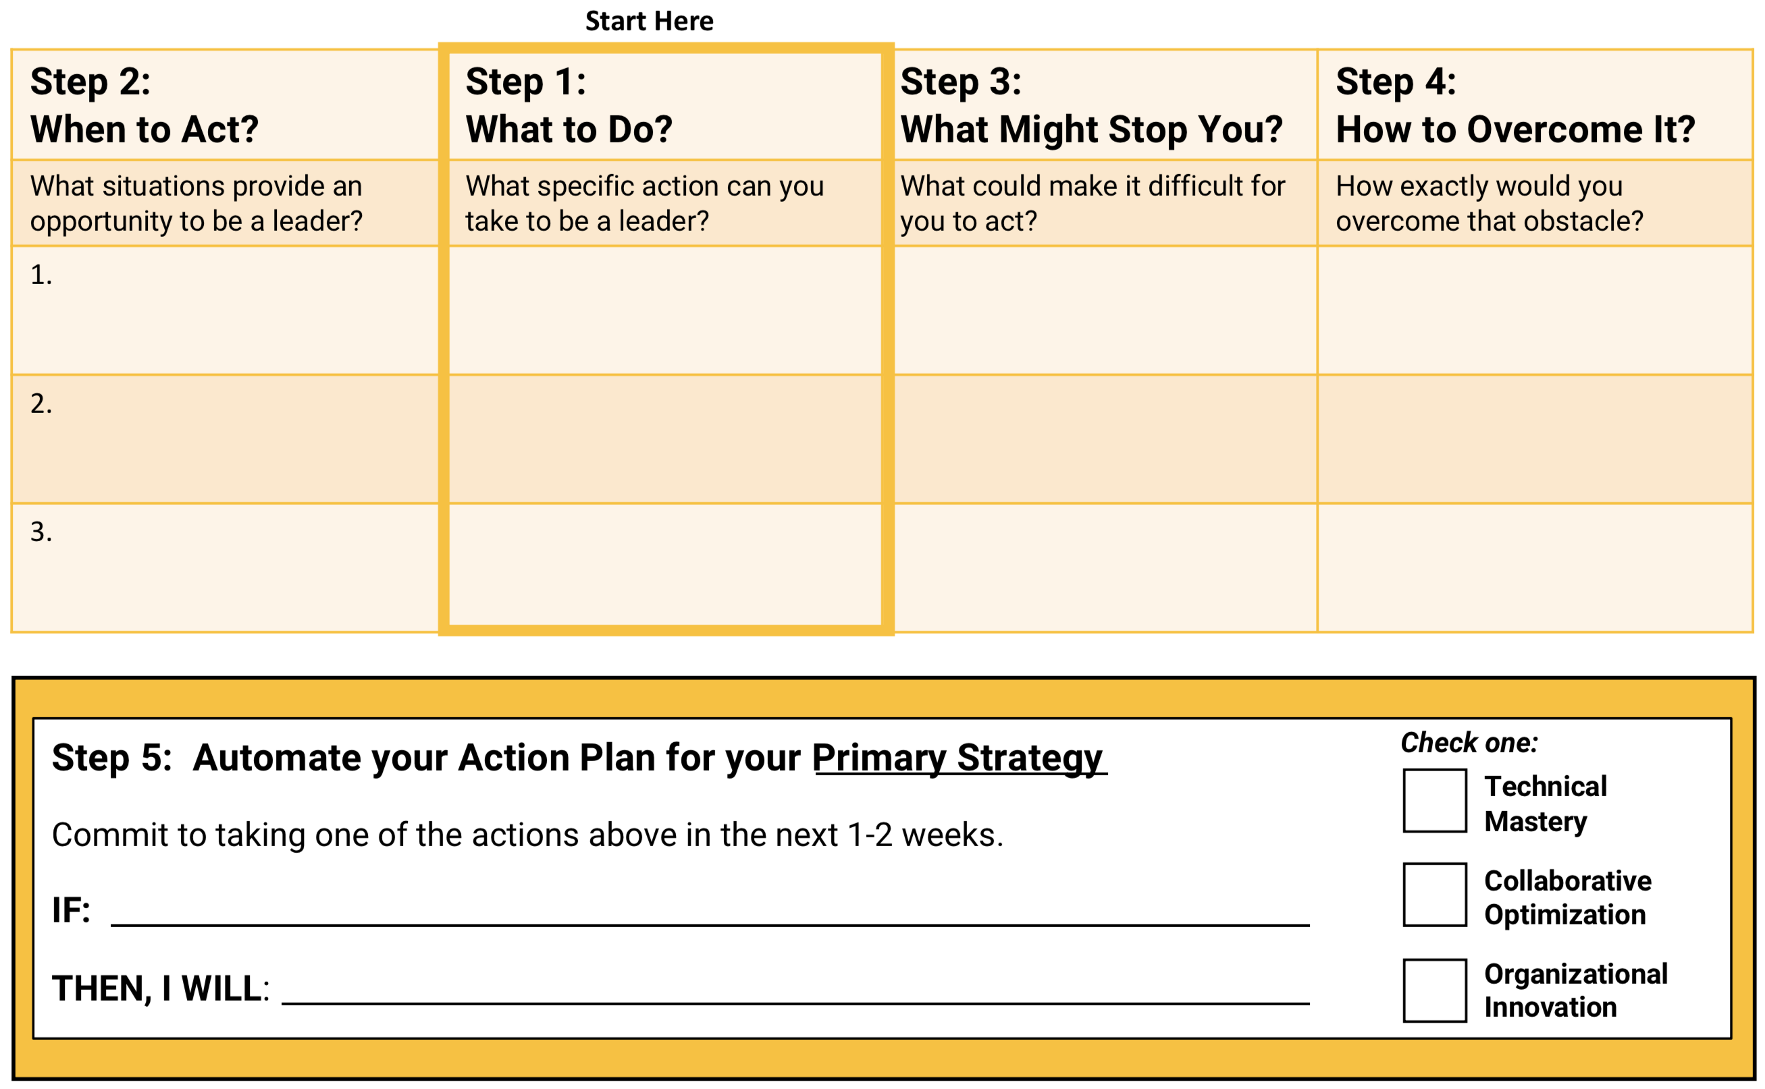
IF I’m in
this situation
Then I will
do this action
But if I encounter
this obstacle
Then I will
navigate by…
Action Plan for Primary Strategy
Choose actions that you can do within the next 1-2 weeks
Putting it together makes it
automatic
Notes:
Now its your turn…
So next we are going to have you walk through your action plan.
Pull out the pink-coloured sheet label Action Plan for your Primary Strategy.
We will do this one first because thinking about what concretely you are already doing might help others at your table who are trying to find ways to develop that kind of leadership strategy.
So step 1 is actually to identify what specifically you want to do.
And you want this to be something you could actually visualize yourself doing, and that you could do in the next two weeks while these ideas are still fresh.
Then secondly identify the specific situation that can cue you to do that action.
Third, what might stop me, and finally, if that ends up blocking me I will navigate that by doing this thing to overcome it.
I’ll be giving you a few (2-3) minutes to fill this out. So you go through these four steps and try to fill out at least one line or maybe two. And at the end of that, you'll be able to come up with an if-then statement and we’ll discuss some of these strategies together.
[Give participants about 3 minutes to complete at least 1 row of this Primary Strategy sheet and fill in the If-THEN. Emphasize focus on spelling out how they could build upon their current strengths.]
[At 3 min mark, encourage them to make sure they complete the IF, THEN at the bottom.]
We’ll be collecting these sheets later but you’re welcome to snap a photo of your worksheet if you want to keep the content.
Add some mention about why we would do primary first…easier to first think about how to build on strengths & share those with each other.
Best to thinking about a specific action you could actually visualize doing
Forewarn that they will be invited to share with their table.
This will give them a chance to get feedback
They will later be putting their finalized If/then on the action cards

Slide 39

Crowd-Sourcing Leadership
✓
Write IF-THEN intentions (5 min)
Share your plan at your table (5 min)
Notes:
Okay, so now that you had a few minutes to complete that for yourself, I want you to spend 5 minutes sharing your action plans at your table.
Focus on sharing whatever you are comfortable with and discuss what you think would work best.
You might also give each other feedback on how to be as concrete as possible in specifying actions you can specifically take.
[Give tables 5 minutes to share and discuss each other’s action plans. Focus them on sharing ones they are comfortable talking about and that they are likely to actually do. Participants should give feedback on what would be most successful and how to make their plans as concrete as possible.]
[Each table shares general themes and action plans with the room with an emphasis on crowdsourcing each type of leadership. (~5 min)]

Slide 40
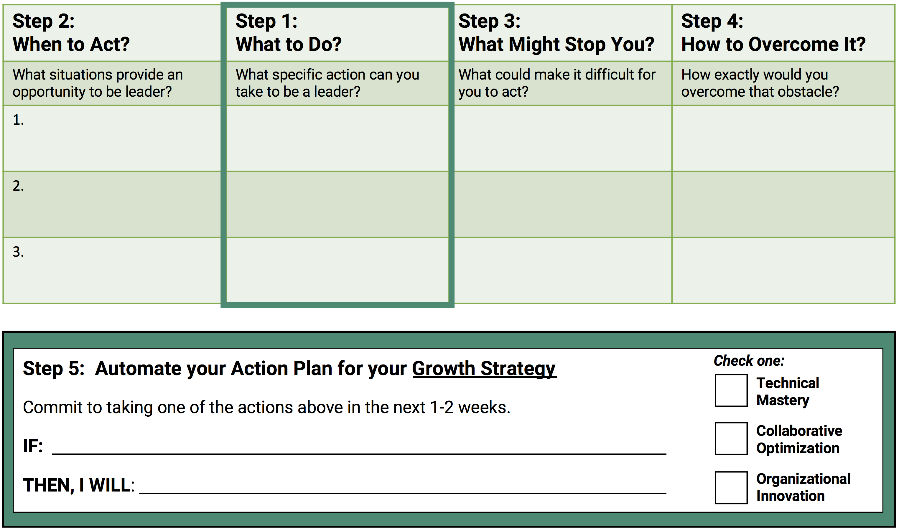
IF I’m in
this situation
Then I will
do this action
But if I encounter
this obstacle
Then I will
navigate by…
Action Plan for
Growth Strategy
Choose actions that you can do within the next 1-2 weeks
Putting it together makes it
automatic
Notes:
Okay, now that we’ve had practice thinking about the leadership strategies we already feel comfortable with and maybe how we can strengthen those and learn from others.
Next we’re going to do the same thing for the action plan and growth strategy.
So now turn to the green side labeled Growth Strategy.
So same deal. Start with identifying some specific actions you could take for that type of leadership.
Then what is the situation that can trigger this, what might stop you, and how would you overcome that obstacle.
Again, do this for one or two lines and then choose on as a concrete IF-THEN action plan to list at the bottom. Ok, any questions?
So another 3 minutes or so to do this.
[Give participants 2-3 minutes to complete at least 1 row of this Growth Strategy sheet and fill in the If-THEN. Emphasize focus on spelling out how they could develop a new strategy for leadership.]

Slide 41
Crowd-Sourcing Leadership
Idea here is on the second round to wrap this up with 5 min discussion with room more broadly.
✓
Write IF-THEN intentions (5 min)
Share your plan at your table (5 min)
Discuss what works best with room
Updated wording for last point (because “group” was unclear).
Timing is flexible (can be less than 5 min)
Notes:
Okay so now that we’ve got some really concrete strategies, you have 10 minutes to share these at your table since we really want to give you time to discuss ways to stretch your leadership strategies and take on some types of leadership that you aren’t already inclined to do.
[When time is up, popcorn one example of an IF-THEN statement for each type. Maybe also talk a bit about obstacles that people foresee.]
[Focus them on sharing one’s they are comfortable talking about and that they are likely to actually do.]
[Participants should give feedback on what would be most successful and how to make their plans as concrete as possible.]
[Each table shares general themes and action plans with the room with an emphasis on crowdsourcing each type of leadership. (~5 min if there is time)]
[Perhaps give guidance for people to specify their If and their THEN.]

Slide 42
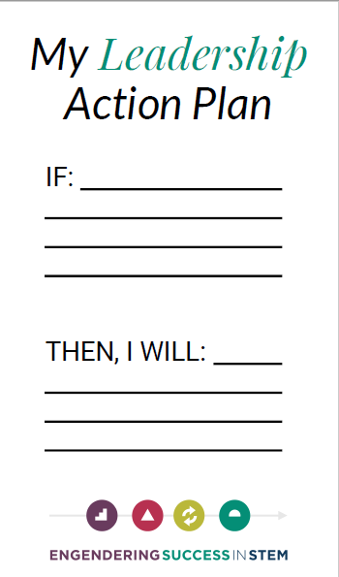

Give Yourself a Leadership “Nudge”
Note, addition of first bullet point by way of reminder
Take photos of your action plan worksheets
Write down your finalized action plan on a card
Send periodic reminders of your leadership intentions:
  Weekly: every(dayofweek)@Nudgemail.com
    e.g., everyTuesday@Nudgemail.com
  Monthly: monthly(#dayinmonth)@Nudgemail.com
    e.g., monthly5@Nudgemail.com
Don’t Forget to
Take Action
Notes:
We want to emphasize that this is not just a theoretical discussion; these are actions we want you to make a commitment to carrying out.
So if you had the opportunity to get some feedback, maybe you've rethought some of the things that you might plan to do.
We encourage you now to update your IF-THEN action plans and write the final version on this card and keep it with you.
Stick it inside your phone, slide it into your wallet, put it on your dashboard in your car, whatever makes sense it will make it real to you and will remind you to take action.
You can also set up an email if you just e-mail every Tuesday at Nudgemail you'll get an email every Tuesday reminding you of this leadership action plan you set for yourself.
Or you can set up a calendar reminder. You can do whatever you want to send yourself a nudge.
Choose a feasible action plan that you think will be most valuable for helping you achieve your leadership goals.
To unsubscribe, type unsubscribe@nudgemail.com

Slide 43
Growth strategies can expand our leadership skills
IF-THEN action plans turn growth strategies into actions
Effective action plans:
  Target achievable actions
  Clearly identify when to act
  Anticipate obstacles and work-arounds
Notes:
So here is the quick summary. So you’ve identified growth strategies.
You've done one for the area of leadership that you most want to develop and created an if-then action plan to help turn those strategies into action.
You also had a chance to think more about your primary strategy that you want to build on and make even stronger.
Just keep in mind that the most effective action plans target really achievable actions – things you think you can actually do but just aren’t doing much of right now.
They also identify when to act and anticipate what obstacles might come up.
But putting these together and literally mentally committing to these IF-THEN programming, it can help your mind turn this into a new habit. But that does require making sure you follow through.

Slide 44
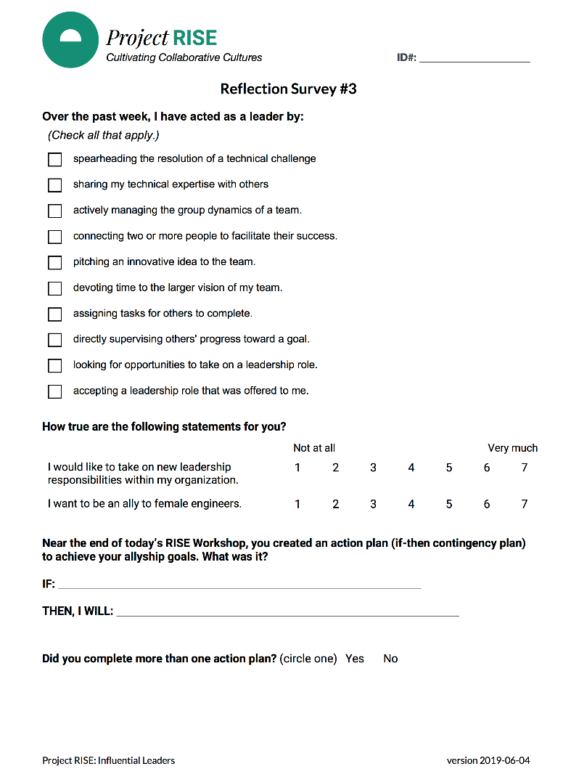
Reflection Survey #3 + Workshop Evaluation
Please complete Reflection Survey #3 (both sides) & Workshop Evaluation
Return all surveys to the envelope.
Notes:
So before we wrap up for the day, we want you to spend 10 minutes competing your final survey and the evaluation of today’s workshop.
Afterward, just return all surveys to the envelope and we’ll say a few final things.
Only needed 10 minutes to complete the final survey.

Slide 45

Wrap Up and Conclusions
We can each do our part to cultivate collaborative cultures by looking for opportunities for everyday leadership.
What is one thing you will take away from today?
Notes:
We can each do our part to take on everyday leadership challenges by understanding our growth strategies and our primary strategies and committing to do something differently.
These can make our work more personally meaningful but it can also help our teams function optimally, and organizations be more innovative and nimble.
In this final wrap up, I’d like to invite you to share one thing that you have learned from today? [get people to share aloud]
What will you take away? Or what will you do differently?
Please feel free to ask more questions or stick around to talk with us over lunch.
Facilitator note to just get people to share aloud NEW THINGS THEY HAVE LEARNED (so different than what they will do)…also encourage them to ask questions or stick around to talk with us over lunch.

Slide 46
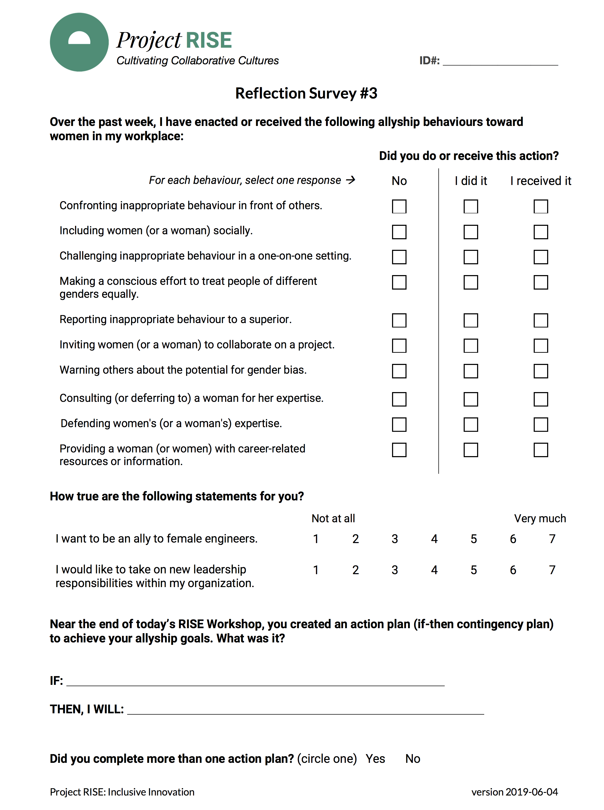

Next Steps
TBD pending question to Dominique re: when NRC folks tend to leave on holiday
Return your envelope with all surveys to one of the facilitators.
  check initials on front and return name badge
Upcoming timeline:
Thank you very much for your active and ongoing participation!
ORG/SITE-SPECIFIC
Dates
✓
✓
Initial Survey
Workshop
Two-Week Follow Up
Mini-Surveys (10 Days)
...
June 2020
Year 2
Abridged
Slides
For follow-up questions about the research: RISE@psych.ubc.ca
Notes:
***HAND OFF BACK TO RISE EXPERT***
And in addition, I want to thank you so much for the time and ongoing commitment you are making to this unique research project.
We literally would not be able to understand the possible benefits or drawbacks to this kind of experience without your responses to our surveys.
So please make sure all your surveys for today are returned to your envelope.
Let me just give a quick briefing on our timeline for the project.
There is going to be another survey coming in [about two weeks/January], so we will ask questions about your experiences in and since the workshop.
After that, there will be a series of brief mini-surveys we will ask you to do for 10 consecutive workdays to get a clearer sense of everyday experiences.
Then you won’t hear from us again for about 6 months.
In year 2, we will contact you for a second set of mini-surveys and a final exit survey.
We will also be updating your organization with aggregated data, in other words, responses to the final evaluation of this workshop averaged across participants.
We will never share any personal or individuating information with your organization.
Final results will include data averaged over several organizations taking part in this larger project.
Again, thank you so much for being part of this research.
It really means the world not only to us and to focus on the RISE research team but also to the people everywhere who will benefit from having more influential leadership.
So you are really making a difference and doing something very worthwhile and thanks so much for being here today and for giving us your attention and your commitment.
-general timeline for the rest of the study
follow-up in 2 weeks
Starting in January, will do a series of brief mini-surveys (~5 min) for 10 work days
Won’t hear from us again for 2nd follow-up survey until June 2020.
Year 2, we’ll contact you for a second set of mini-surveys and a final exit survey.

