Slide 1





for the Cultivating Collaborative Cultures project in collaboration with SSHRC & WinSETT
Created by
Notes:
Facilitator notes: Create/insert an appropriate welcoming to the workshop.
Suggested points to touch on are:
- the motivation for the workshop,
- the initiatives it may be possible through,
- and/or expressions of support for the workshop and its goals by representatives of the department/organization (such endorsements have a positive impact on engagement with the workshop.

Slide 2

Ground Rules and Norms
Safety reminder
Highly interactive session
Share from your experiences and perspectives
Active listening and respect for privacy
Make the most of this investment of your day
Minimize distractions
Notes:
So here are some of our suggestions for ground rules and norms that we will all observe in the four hours that we're going to be together this morning.
Facilitator note: At this point, identify the fire safety protocols and any additional safety information that is required.
We do expect this to be a very interactive session. You will be responding to us and interacting with the group as well as with each other for paired work and doing some group exercises as well. We hope that you will be as candid as you possibly can. We really appreciate your honesty and forthrightness and you'll get more out of the workshop in this way.
When you are listening to someone else sharing you will practice active listening. What that means is that you will invite that person to say more about what they're sharing by asking them open ended questions such as: tell me more about that, or what was that like, or how did that feel, to allow them to further explore their experience. You're not going to jump in with criticisms or judgments or “well I have this other story” when we're in active listening mode. We are just helping the other person share more. And we want to have respect for each others’ privacy. We're going to be doing some more introspection and sharing of a more personal and reflective nature. So if the story is not yours to share; please do not share it outside of these walls. Do we have everyone's agreement hand up if you agree to that? Thank you very much.
Since we really do appreciate that you're taking time out of your busy schedule to be part of this workshop we encourage you to engage fully, as that will help you make the most of your time here today. We will be offering suggestions, tools, tips that you can take away from this room and integrate into your everyday way of doing things. This is another way that you will recover your investment of this day, so we encourage you to participate fully and commit to the things that you learn here.
Final thing, we'd like to ask you to minimize distractions if you do need to step out to take a phone call or answer an email or a text please, just do so in the hallway and come back as soon as you can. If that's good with everyone, are there any other suggestions questions comments about this? Okay if we can agree to live by these rules for the next 4 hours we're going to have a fantastic time together.

Slide 3

How and why we work together
Barriers to being inclusive
-- Break
3) Communicating inclusion
Putting allyship into action
Inclusive Innovation
Notes:
So here's our agenda for the morning. We are going to break in about 1.5 hours after we finish some of our introductory stuff around how and why we work together, and we’re going to talk about some barriers to inclusion. After that we’ll be doing a dialogue activity aimed at communicating inclusion and then some steps to put all of what we've learned into action through something called allyship. If you haven't heard of that, you will hear about it and we hope to become inspired to be part of it by becoming an ally yourself. And don’t worry, we’re going to give you lots of opportunities to interact and do fun, interesting activities.
Facilitator note: Take this opportunity to identify if there will be refreshments or lunch provided.

Slide 4
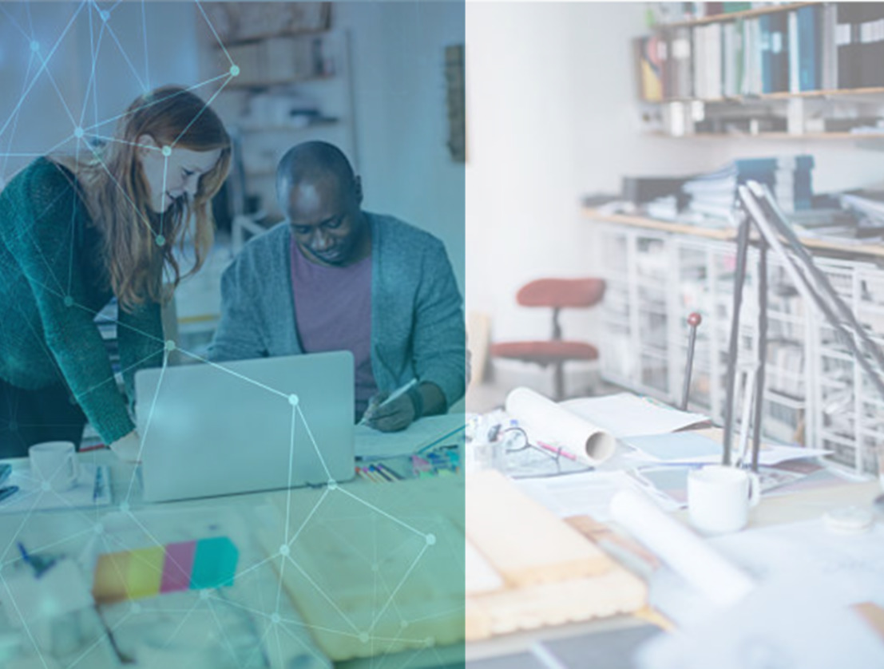
01.1
How We Work Together
Notes:
How we work together
Please take a moment to introduce yourself at your table. You will have 2 minutes to do this. Please keep introductions short, you will have lots of opportunities to learn more during this workshop .
Facilitator notes:
Add any suggested introduction elements to the script above (e.g., please share your name, type of work you do, and pronouns you use)
Timing needed for this slide
Powerpoint just says "begin by having people at the table introduce themselves briefly to each other." Should I delete all of the above?
people at the table introduce themselves very briefly to each other.

Slide 5
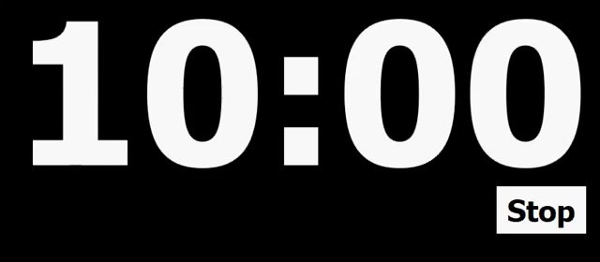
How We Work Together: Design Task
GOAL: BUILD THE TALLEST TOWER
TIMING: 10 MINUTES TOTAL
Use only 30 coloured sheets of paper
Must stand unsupported for 15 sec
Build towers on tables, not floor
Flag us when you are done building
Tear down once measured
+ recycle
1 minute to discuss and plan
Measure in centimetres
THERE IS A PRIZE FOR THE TEAM THAT BUILDS THE HIGHEST TOWER
Notes:
Note, that if energy level seems low, start by mentioning that this is a competition for chocolate. Then give ground rules.
So first, let's start out by how we work together. We're going to give you a chance to do something experiential. You are all seated in table groups. Now, using only the sheets of paper that are on your table, you are going to work as a team at your table to create a tower out of paper. We’re not giving you anything else and we are just going to have to see what you come up with in terms of methods to make the tallest tower possible. It has to stand for 15 seconds with no support from any humans or other things and you're going to build the tower on the table not the floor. Please measure it at its highest point while it is up during that 15 seconds with the tape measure provided on your table. And if you can just wave one of us over, we want to get a picture of your tower when it’s up. There will be a prize, so do your best. We will give you 10 minutes and we are encouraging you to use the first 2 minutes to discuss and plan before you begin building. Please take those 2 minutes to get a plan underway and then you'll have eight minutes to build so here we go I'm hitting go. Any questions? No questions? Okay, your time Starts Now.
Facilitator note: They will be timed while they build their towers. HQP will measure height of towers either when signaled to come over or at the end.]
So now that we've had a chance to build our towers, we are going to discuss this activity a little bit later. We want you just to take a moment to consider some of your experiences. Think about what you saw that worked, what didn't work well. But please just hold those thoughts and we'll get into them a little bit later.
Ensure at least a few of the tables are given paper of different thicknesses, e.g. one group receives cardstock while another receives printer paper . At the end, after the tower has been measured, ask the leaders to dismantle the towers and move the paper to the side of the room. If possible, place recycling bins in the workshop space/room.

Slide 6

01.2
Why We Work Together
Notes:
Time is up! Our team will be coming around to measure your tower and snap a photo.
We’ll return to talk about this task a little later in the morning.
Now that we are reminded of the challenges of working together on a project, under time pressure, let’s think a bit more deeply about this question: Why do we work together? And perhaps more specific to the work we do as scientists/engineers, why do we work together to do the kind of work we do? What do we gain from working as a group?

Slide 7
RISE Workplace Culture Survey (2018)
1259 employees in STEM fields
Notes:
The creators of this workshop, the Project RISE team, have data to speak to this. In 2018, Project RISE carried out a Workplace Culture Survey with 1259 STEM employees, and overall you can see the diversity in sector, age, and status in the field.
An important point to note is that in today’s workshop, we are often describing research related to those who self-identify as either being women or men, or the stereotypes we all have about binary gender categories. But we also recognize that not everyone sees themselves in gender binary terms, and it is valuable to keep space for the experiences of broader forms of diversity that might be represented in our group.

Slide 8

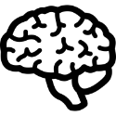

Three Core Values in Science and Engineering
Personal Enrichment
Intellectual Stimulation
Societal Engagement
Achieving and sustaining financial security
Pursuing a meaningful, impactful career
Fulfilling a professional ‘calling’
Upholding the dignity of the profession behaviour
Finding evidence-based solutions to complex problems
Satisfying intellectual curiosity
Creating transformative technical innovations
Making valued contributions at work
Serving the community
Promoting societal equity and fairness
Advancing societal welfare
Supporting a sustainable future
RISE Workplace Culture Survey, 2018
Notes:
The RISE team took all of the responses they got from those 1259 people and identified 3 core values that most people responded to as being very important to them.
There's personal enrichment, which is all about what's in it for me. I don't think there's anything wrong with wanting to have a successful career, a lucrative career, something that makes you feel like you're upholding a calling.
Next is intellectual stimulation, which is all about that curiosity and drive to solve more complex problems and do more interesting things. This is also a big driver for folks who work in science and engineering,
And finally there's this sense of wanting to give back or serve a broader purpose, serve the community. Making sure we protect the environment or take care of the people in a specific community or around a certain project.

Slide 9


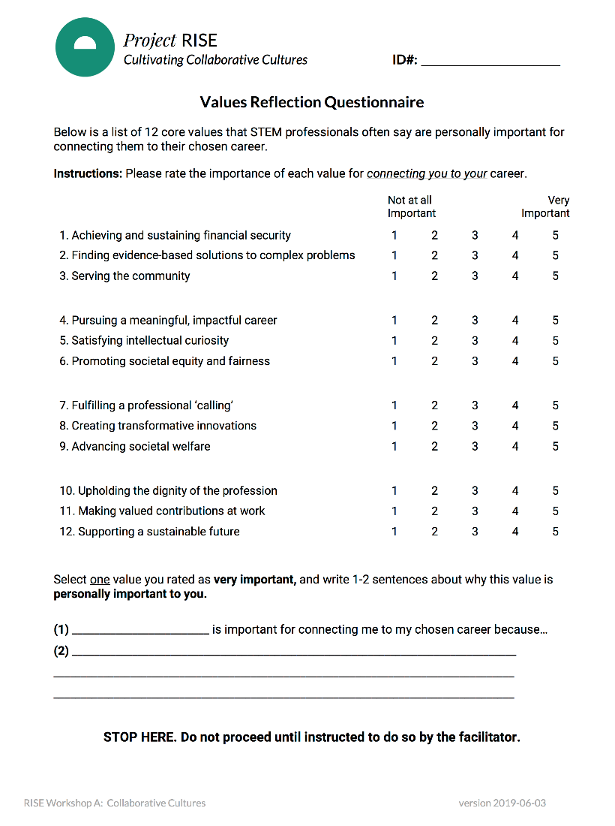
Values Reflection Survey
Please complete the Values Reflection Questionnaire.
Notes:
These are the three buckets of core values. If you haven't completed the values questionnaire please do so now.

Slide 10
What Is Your Top-Rated Value Category?
1
Have you completed the Values Reflection Questionnaire?
Scoring your values:
2
Add up ratings for items 1 + 4 + 7 + 10 = ______________
Personal Enrichment
Add up ratings for items 2 + 5 + 8 + 11 = ______________
Intellectual Stimulation
Add up ratings for items 3 + 6 + 9 + 12 = ______________
Societal Engagement
Notes:
So you have completed the values questionnaire. I would encourage you at this point if you haven't done so already to take a moment and score yourself on these different values.
NOTE: Participants cannot score their Values Worksheet until we provide this scoring key.
Participants are asked to retrieve the value reflection questionnaire. If participants have not already completed the questionnaire, they can do so now before proceeding to scoring.
Participants who have completed the value reflection questionnaire may proceed to scoring.
Scoring procedure:
Each value category is separated by its position in the 4 blocks:
Category 1 – Personal Enrichment – first value in each block (4 total ratings)
Category 2 – Intellectual Stimulation – second value in each block (4 total ratings)
Category 3 – Communal Engagement – third value in each block (4 total ratings)
Participants should sum up their 4 ratings (ranging from 1-7) for each value category to yield 3 different total scores (scores can range from 4-28).
The value category for which participants have the highest total score is their top-rated value category.
Once all participants have completed the value scoring process, they may proceed to paired discussion.

Slide 11

Let’s Start the Conversation
Meet your discussion partner
Name tags share same sticker
Several conversations throughout the day
Notes:
Next you're going to have a conversation with the person beside you, who should have the same colour sticker as you on their name tag. That is your conversation buddy and you will be chatting together throughout the workshop.

Slide 12
Question Set 1 Answer both, then swap roles (5 min)
Person 1 starts: Why is your own top-rated value important for connecting you to your field?
Person 2 responds: Why is Person 1’s top value important to the field as a whole?
Personal Enrichment
Intellectual Stimulation
Societal Engagement
Achieving financial security
Pursuing a meaningful career
Fulfilling a professional ‘calling’
Upholding the dignity of the profession
Finding evidence-based solutions to complex problems
Satisfying intellectual curiosity
Creating transformative technical innovations
Making valued contributions
Serving the community
Promoting societal equity
Advancing societal welfare
Supporting a sustainable future
Sum items 1, 4, 7, 10
Sum items 2, 5, 8, 11
Sum items 3, 6, 9, 12
Notes:
Did many of you find that you share similar values? (to get the head nod)
Facilitator note: Don’t make salient that they might have different values.
The first conversation we'd like to invite you to have is about your values. Which of the three values came out as highest for you? There is no right or wrong answer but we're inviting you to reflect on that value and say why is that important for you in terms of connecting to your chosen field of science or engineering. Or how does that value show up for you as important in your day-to-day life? Then your partner is going to chime in and say why they think that your value is important to the field as a whole. So you're both looking at your value initially and then you're going to switch and you're going to talk about your partner's specific value. They are going to explain how that value is important to them personally, and then you are going to say why that particular value is important to the field as a whole and what that means in terms of bigger picture impact. Anyone have any questions? You both have 5 minutes to discuss both your values so I'll cue you to move along. Thank you so much.
All right, so something that we can see is that you many of you probably had shared goals and values. How many of you had the same shared value as your partner? Even if you listed a top value different than that of your partner, how many of you were able to see how that value is important in your field or organization?
Popcorn on why each of the three values are important to the field

Slide 13


Intellectual Stimulation
Allows us to solve problems effectively
Allows us to advance in the profession and pursue our professional goals
Allows us to serve clients in the community and contribute to society
Shared Goals
Personal Enrichment
Societal Engagement
Notes:
You have now had a chance to talk about what these values mean to you personally, and to the field more generally. And what you might have already recognized is that these values overlap to come degree to provide a motivational backdrop to our shared goals.
In fact, our organizations and the people in them tend to function best when our work integrates these different values
When people find personal enrichment → they do their best intellectual work
Innovative solutions –> are needed to benefit broader society
Working for the good of society → often create a strong feeling that work is personally meaningful.
Facilitator note: Facilitator organically mentions other themes that have been brought up in the larger group, if any. Avoid adding too much time to this slide by keeping to one or two extra points.

Slide 14
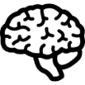


All Three Values Matter to STEM Professionals
Innovative
Problem-Solving:
a Key Shared Value
Extremely
important
Extremely
unimportant
Personal Enrichment
Intellectual Stimulation
Societal Engagement
RISE Workplace Culture Survey, 2018
Notes:
The RISE data on these values suggests that all three values are rated as being highly important
And among these three, intellectually stimulating-problem solving is a highly important shared value.
In fact, it’s often the basis for how we describe our careers as scientists/engineers.
Shnabel et al. (2013) – writing about how value connects one to other people is especially effective for negatively stereotyped groups. One key feature of this component should be how these values connect scientists/engineers and help them function together.

Slide 15
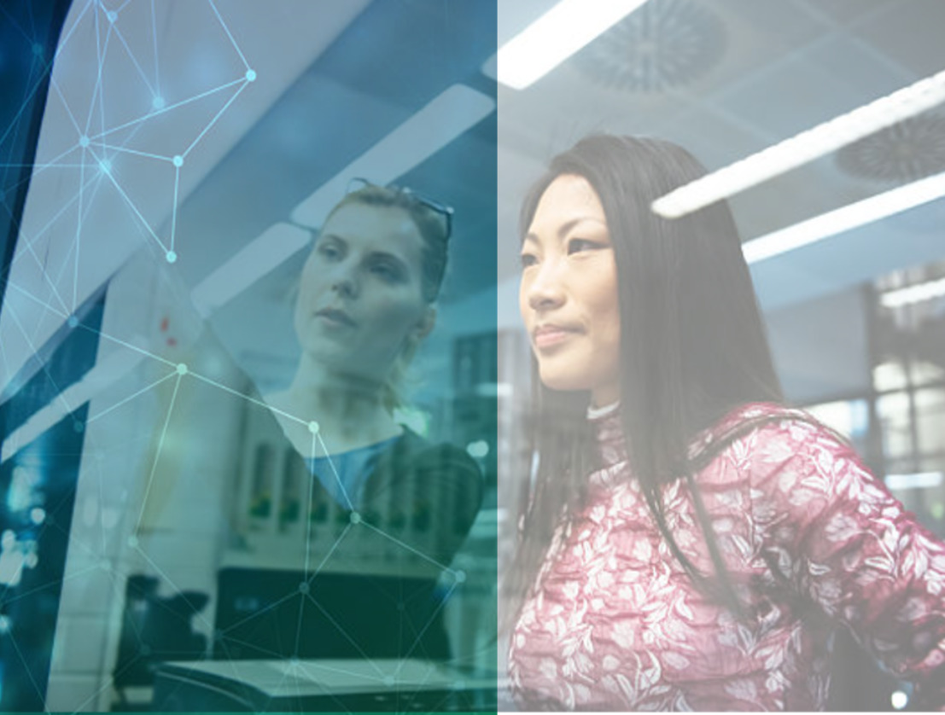
01.3
Diversity: Challenges and Opportunities
Notes:
Moving beyond these values, when we talk about diversifying our workplaces there are many challenges and opportunities that exist.

Slide 16
Key Challenge: Managing Differences in Groups
Groupthink
Capitalizing on Differences
A
?
A
A
A
A
A
B
C
D
Homogenous or majority view
Focus on consensus
Self-censorship
Suboptimal decisions
All opinions are valued
Focus on strength of evidence
Demographic diversity helps
Improved decisions
Janis, 1972; Phillips, 2014
Notes:
Although managers sometimes worry that diversity can get in the way of successful team dynamics, research suggests that a much bigger problem is having team members who are all encouraged to think about problems from the same homogenous perspective.
In science and engineering, its critical to guard against group think. We need to capitalize on differences in perspectives, expertise, and experience.
need the best work and ideas from all team members;
need effective communication
it’s a problem if some feel disconnected from the team, the organization, the work
Because of this, research often suggests that the teams that make the best decisions are the teams that are demographic diverse, where everyone’s opinions are values, and where decisions focus on the strength of evidence not the need for consensus.
In short: Teams function best when diverse voices are heard.

Slide 17

Why Do We Care About Diversity and Inclusion?
A knowledge & innovation case
  Diversity in science yields a comprehensive knowledge base (Fehr, 2011; Longino, 2002)
  Diverse teams are more creative and cognitively flexible (Galinsky et al., 2017; Page, 2007)
Notes:
This discussion brings us to a central question that will ground the rest of what we do together today: Why do we care about diversity and inclusion? Its one thing to care about getting things right and hearing everyone’s opinion, but why do we care about demographic diversity (and in particular gender diversity in STEM) as one means to get there?
Diversity and inclusion isn’t just important for individual well-being, but also at the organizational or institutional level. One indicator of inclusion – or lack thereof – is the degree to which men and women report a belief that others at work judge them based on their gender. At some organizations in RISE’s studies, women reported concern that their gender influences how they are perceived by others at work at significantly higher levels than men in the study. Overall, about a quarter of women sampled agreed that they experience this judgement frequently. We know from existing research that these concerns undermine women’s feelings of inclusion and belonging in their STEM workplace.
In addition to the well-being of individual employees, we suggest there are three good reasons at an organizational level to care about inclusion. One has to do with the quality of the work we do.
In science, the very questions we pursue are often guided by our own experiences. When science is done by a homogenous group of people, certain questions go unstudied. Diversity in science, therefore, helps to yield a more comprehensive knowledge base.
In addition, diverse team are often more creative and cognitively flexible. They might disagree with each more, but the result is often a better and more innovative solution.

Slide 18

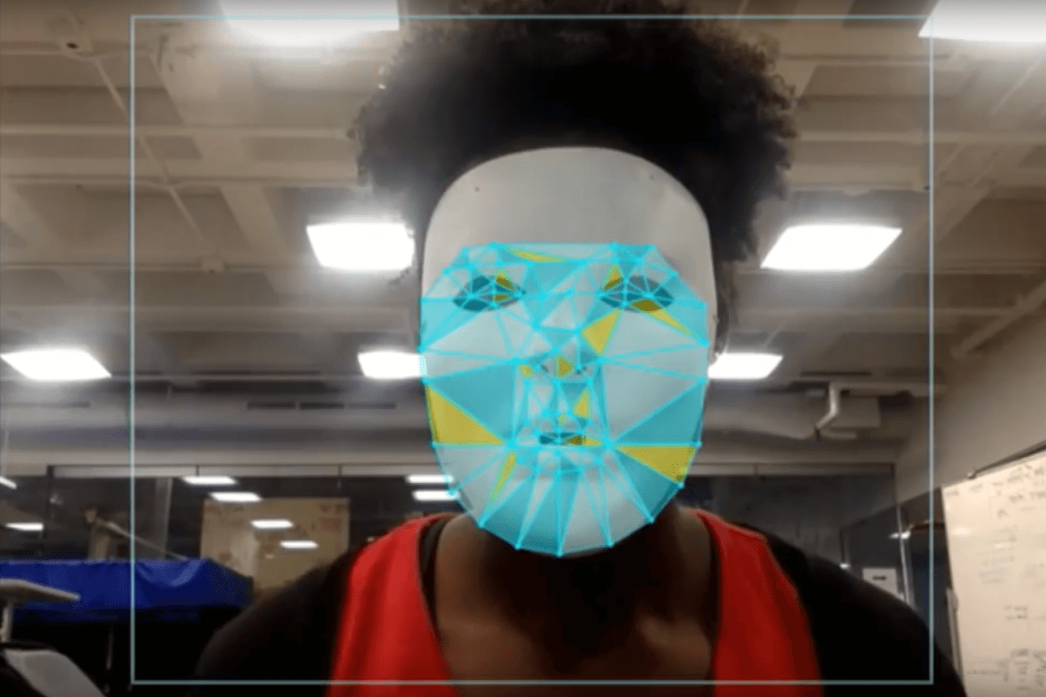
Facial Recognition Failures
Joy Bualamwini
MIT Computer Scientist
Notes:
There are many salient examples of how a lack of demographic diversity on teams has led to key problems in the final product.
For example, Joy Bualamwini, a computer scientist at MIT, has spoken publicly about how first generation facial recognition software could not detect her face because it had only been tested on light skinned faces.
This is her with a white mask that she would to wear to be seen by this software.
Facilitator Note:
- You are welcome (and encouraged) to find recent or more field-specific examples of how lack of diversity affects STEM productions. Below is an alternative
https://www.theguardian.com/technology/2017/dec/04/racist-facial-recognition-white-coders-black-people-police
http://fortune.com/2018/09/14/fight-algorithmic-bias-joy-buolamwini/
https://www.washingtonpost.com/technology/2019/10/22/ai-hiring-face-scanning-algorithm-increasingly-decides-whether-you-deserve-job

Slide 19
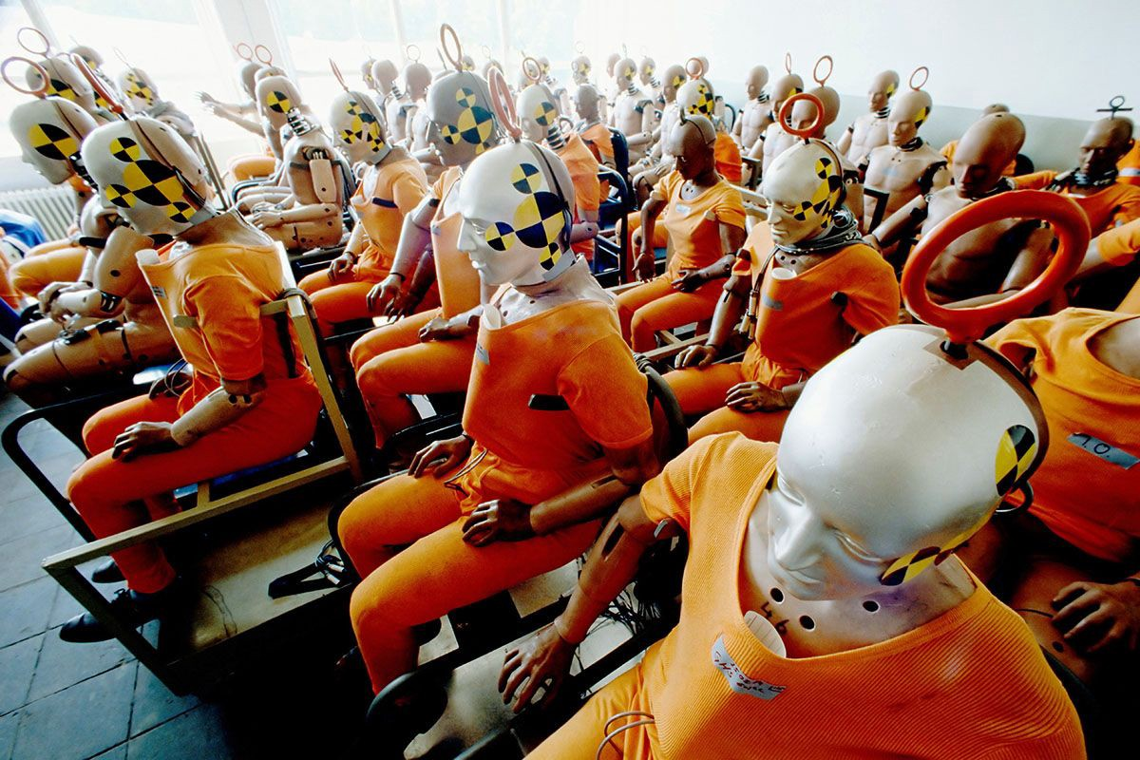
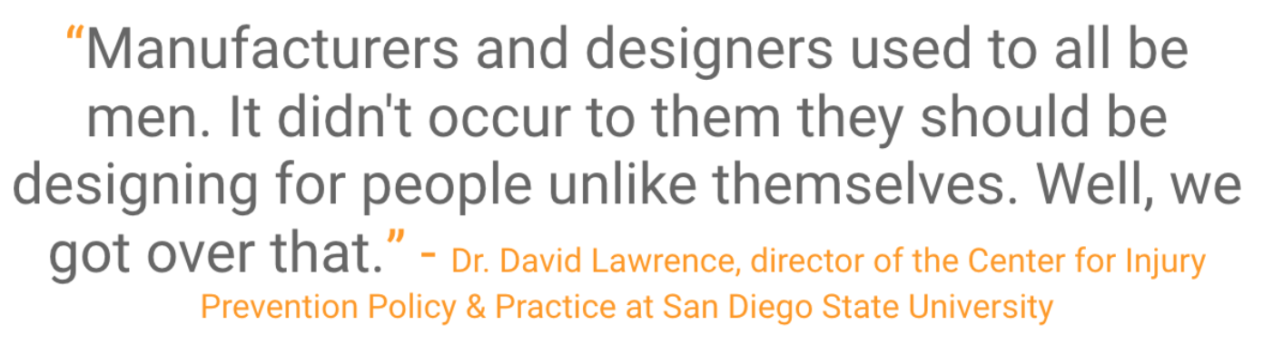
Safety Failures
Notes:
A lack of diversity at the design stage can also have implications for public safety. Until quite recently, all Crash Test Dummies were based on an average-sized man and as a result, women and children were more likely to die in car crashes.
As this quote says men simply didn’t think to design for people unlike themselves.
This specific problem has been corrected but it’s another reason that we need to get this right.
https://medium.com/@AnnaJS15/where-are-all-the-female-crash-test-dummies-a1391795be41

Slide 20

Why Do We Care About Diversity and Inclusion?
A knowledge & innovation case
  Diversity in science yields a comprehensive knowledge base (Fehr, 2011; Longino, 2011)
  Diverse teams are more creative and cognitively flexible (Galinsky et al., 2017; Page, 2007)
An economic case
  Diversifying the labour-pool can help meet labour shortages (Government of Canada, 2012)
  Companies perform better with more diverse leadership (Carter & Wagner, 2011)
Notes:
These examples highlight how having a more diverse group of people designing products can lead to better outcomes that benefit more of humanity.
These benefits can also help to make an economic or business case for diversity.
And, in fact, some research suggests that companies perform better with more women in leadership positions. Not to mention the fact that diversifying the [pool of available workers/talent pool] can help us meet labour shortages in many careers.

Slide 21
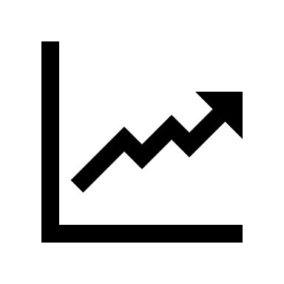
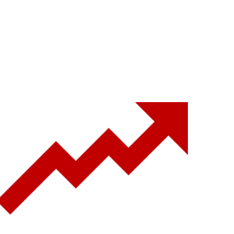

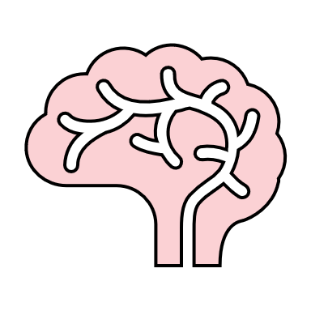

An Economic Case
Improved Governance
More Innovation
Access to More Talent
Fortune 500 companies with the most women on board of directors outperformed companies with the least.
  Carter & Wagner, 2011
Notes:
For example, research has shown that Fortune 500 companies with more women on the board of directors outperformed companies with less.
These financial benefits were seen both on return on sales and return on invested capital. Why did these companies benefit from greater female leadership?
The authors suggest that it is a combination of having greater innovation, greater access to talent, and improved government.

Slide 22

Why Do We Care About Diversity and Inclusion?
A knowledge & innovation case
  Diversity in science yields a comprehensive knowledge base (Fehr, 2011; Longino, 2011)
  Diverse teams are more creative and cognitively flexible (Galinsky et al., 2017; Page, 2007)
An economic case
  Companies perform better with more women in leadership (Carter & Wagner, 2011)
  Diversifying the labour-pool can help meet job shortages (Government of Canada, 2012)
A fairness case
  Dismantling barriers promotes equal opportunities
Notes:
The third and—many would argue—most important reason to care about inclusion, is the simple fact of fairness.
Before the industrial age, men would often work for payment outside of the home, relying on women to mange domestic work and full-time childcare. But since the early 1900’s and into the information age, cultural and technological advances have allowed us to break clean of these traditional divisions. This creates extraordinary opportunities because we have women who are skilled and dedicated STEM professionals, and men who are exceptional at domestic work and creating a family home. So there really is no objective reason to pigeonhole people into different roles. Instead, we want to promote equal opportunity for anyone to do what they want to do regardless of who they are. And yet these longstanding gender roles can create hidden, structural barriers to women’s inclusion in STEM.
If, as we will argue a bit later, there are currently barriers to fully including women and other underrepresented minorities in science and engineering, then how can we, as the expert problem solvers that we are, work together to dismantle these barriers?

Slide 23
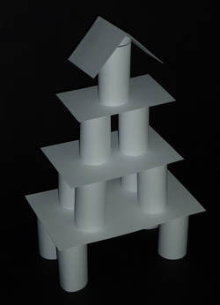
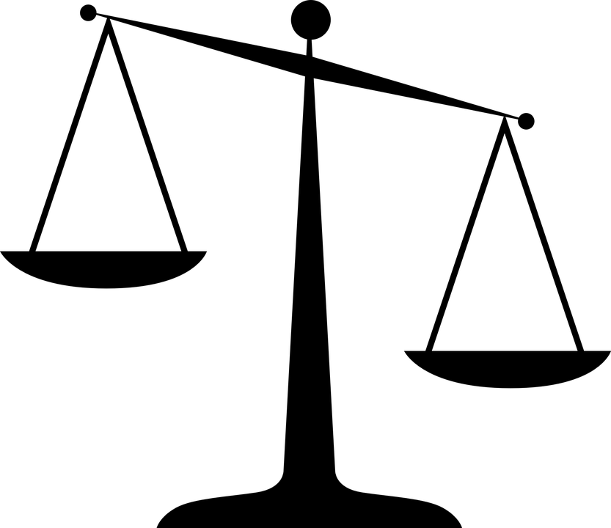

Design Task: Who Was Most Successful?
Congratulations to the
Winning Group
What was the secret
to your success?
Some teams had 65 lb paper
Other teams had 24 lb paper
The benefits and blindspots of structural advantages
Notes:
Let’s think a bit more about fairness by going back to the design challenge we had the start of the morning:
The winning tower was: ___________ [indicate group]
[Ask members of that group to talk about their approach and why think it was so successful]
[Ask others in the session to comment on what helped this group succeed?]
Did any of you notice any systematic advantages that this group might have had?
[Ask those with the thinner paper if they noticed how hard the paper was to work with]
Often the structural advantages we have in life are hard for us to see. But the fact of the matter is that many aspects of our identities can set some of us up to succeed, while other identities can place hidden barriers to success for others.

Slide 24

All STEM professionals share three core values
Innovative problem-solving is a common goal
A lack of diversity and inclusion can undermine innovation
How can we apply our focus on problem-solving to cultivate inclusive workplace cultures?
Notes:
So, to sum up, STEM professionals share many values, especially a passion for solving problems.
A key problem is that lack of diversity and inclusion on our teams can undermine our ability to be truly innovative, successful, and fair.
So today we are asking you to work together to think about how to solve the problem of cultivating a more inclusive environment in your workplace.

Slide 25
Reflection Survey #1
Please take three minutes to complete Reflection Survey #1
Notes:
Please take three minutes to complete Reflection Survey #1 .

Slide 26
How and why we work together
Barriers to being inclusive
-- Break
3) Communicating inclusion
Putting allyship into action
Inclusive Innovation
Notes:
Let’s dive deeper into the specifics of barriers to inclusion.

Slide 27
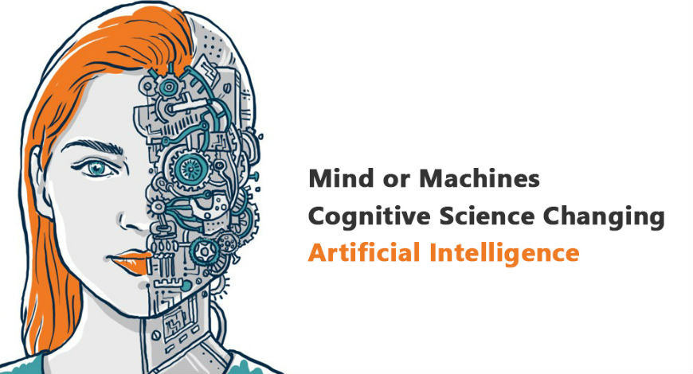
Barriers to Inclusion:
The Cognitive Science of Bias
Notes:
Now we have discussed why inclusion is so important to meeting our shared goals for developing the most creative and innovative solutions to problems.
However, when we work in diverse teams, implicit biases can be a barrier to success.
The Project RISE team and its research leads are well-positioned to discuss the consequences of bias, including racial and gender stereotyping, due to their PhD levels of training and over 15 years of researching these topics.
Today I will share some of the insights of this research with you.

Slide 28
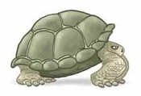

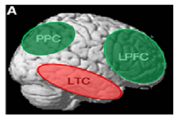
Thinking Fast and Slow
Reflective system for controlled processing [System 2]
  Deliberate, propositional reasoning
  Effortful, requires motivation
  Takes more time
Reflexive system for automatic processing [System 1]
  Relies on implicit associations and procedures
  Requires little effort
  Fast
Different neural systems distinguish the two
  Lieberman, 2007; Satpute & Lieberman, 2006
Evans, 2003; Kahneman, 2011
Notes:
The Nobel Prize-winning economist, Daniel Kahneman, is famous for his insight that people think at two speeds: fast and slow.
The slow system is the one you are using right now to pay attention to what I’m saying. This reflective system is what we use for controlled processing and rational decision-making. As scientists, or engineers, we like to think of ourselves as reflective thinkers. The type of people who always act based on a conscious consideration of the evidence. But the reflective system is more effortful. It requires motivation and time.
Fortunately, our brain has evolved its own form of autopilot that we use for automatic processing. This system relies on implicit associations and learned procedures. It requires much less effort. It operates really quickly, sometimes even outside of our conscious awareness.
So, if you’ve ever had the experience of driving home from work fully intending to stop at the store and suddenly you realize you're sitting in your driveway and you don't really even remember having made the turns that you made, you realize that your brain has this capacity for navigating a 2-ton vehicle down the road without consciously thinking about it. That’s our reflexive system in action.
This reflexive system is quite functional – it allows us to accomplish things on based on the well-practiced procedures, and neuroscience research suggests that different neural systems underlie these two modes of processing.

Slide 29
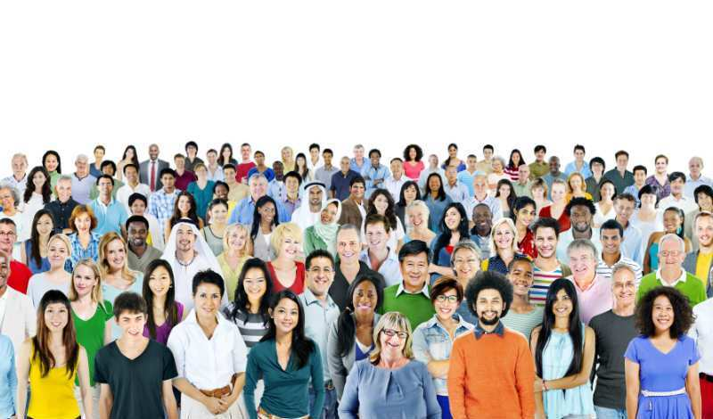
Reflexive system falls back on stereotypes
Notes:
But when it comes navigating interactions in a diverse world, problems can arise because this fast-operating reflexive system all too often falls back on using stereotypes as quick ways to make sense of people.
And these stereotypes themselves get automatically learned by the reflexive system from the roles that people have in the world around us.

Slide 30
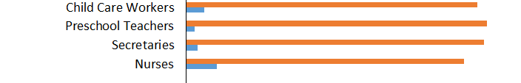

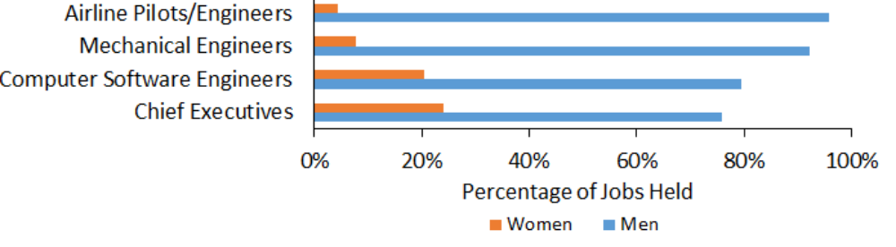

We Assume People Are What We See People Do
Unequal distribution of men and women in occupations creates stereotypes
Caring
Nurturing
People Oriented
Mechanical
Task Oriented
Leaders
Eagly, 1987; U.S. Department of Labor, Bureau of Labor Statistics, 2009
Notes:
In other words, it is because we have an automatic tendency to assume that people are what we see them do…any unequal distribution of men and women in different occupations is actually what leads to the gender stereotypes we have.
If we see that more women take on jobs as teachers or nurses, our reflexive system assumes that women are just more caring people.
And if we see more men in engineering and as CEOs, then we assume the men are inherently mechanically minded and leaders.
But research on men’s and women’s personality traits and abilities does NOT actually show large gender differences to back up these assumptions.

Slide 31
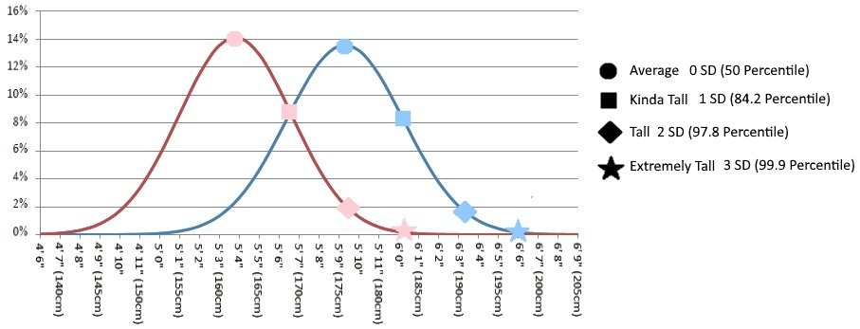
How Different Are Men and Women Really?
Sex Differences in Height
d = 1.72
Women
Men
Source: Tall.life
Notes:
How different are men and women really?
Let’s put this question in perspective by first looking at differences in height. It’s a fact that men are, on average, taller than women. The average gender difference in height is quantified as a d of 1.72, which means the average height difference between men and women is just below 2 standard deviations – that’s considered a very large effect. But even so, these are overlapping distributions where a good percentage of women are still taller than a good percentage of men.
In psychology, for over a half century or more, people have been designing tests to measure personality traits, cognitive abilities, and behavioural tendencies. Researchers have recently synthesized all of these data to answer the question about overall average differences based on gender. What do they find?

Slide 32
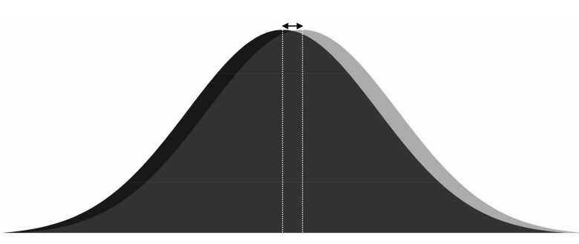
Men and Women Are More Similar Than Different
Absolute value of d = 0.21
Men
Women
Across 386 different personality and performance effects
Zell et al., 2015
Notes:
That is, across 386 different effects, men and women are much more similar than they are different.
There are tiny average differences amounting to a fifth of a standard deviation.
Importantly, this analysis averages the absolute values of the differences, meaning any traits favouring women and traits favouring men cannot just “cancel” each other out.
This varies based on the trait one is looking at, but the degree of overlap is striking.
On relevant measures like math ability and leadership effectiveness, there are no overall gender differences that can explain or justify the low numbers of women in STEM.
But yet, we still tend to have an automatic stereotypes that associates STEM more with men than with women.

Slide 33
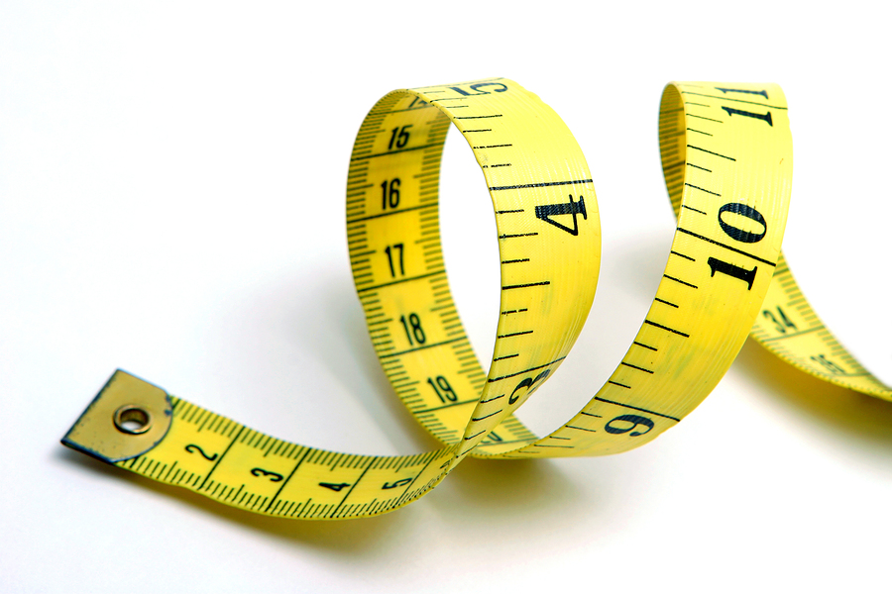
How do we measure implicit associations?
Notes:
How do we measure these persistent implicit associations?
Over the past two decades, researchers have created and validated measures we can use to quantify these implicit associations that underlie our reflexive use of stereotypes.

Slide 34
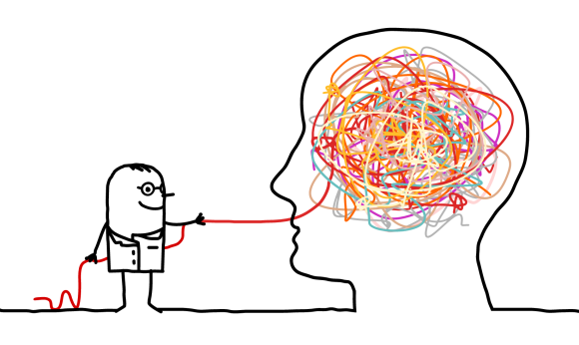

The Implicit Association Test
Implicit Associations are cognitive links between concepts that co-vary
Distinct from explicit intentions
Validated on over 20 million participants
SCI-IAT
ENG-IAT
    Greenwald, McGhee, & Schwartz, 1998; Kurdi et al., 2018
Notes:
We can do this with something called the implicit association test.
Implicit associations are cognitive links between concepts that co-vary. I say clouds, you think rain because your reflexive system has learned to link these two together. And to the degree that there are still more men and women in engineering, we can expect to see the same thing for a link between engineering and male.
These implicit associations are distinct from our explicit intentions. So It doesn’t matter if we want or intend to associate engineering more with women, our reflexive system simply finds it harder to make this connection.
The most recent meta-analysis has validated this measure on over 20 million participants.
We can demonstrate what these associations look and feel like in an interactive task. You will need your hands free to do this task.
[click on the engineering link to do the demo; takes me 5 min to get to the IAT]
Source for 20 million participants claim: Source: “Since its founding in 1998, more than 20 million people have completed studies at the Project Implicit websites.” https://implicit.harvard.edu/implicit/blog.html

Slide 35
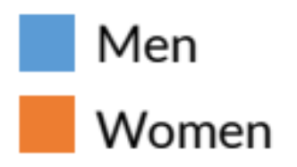
Implicit Associations ≠ Explicit Motivation
Both Men and Women have an Implicit
“Think STEM, Think Male” Bias
But are Explicitly Motivated
to Support Gender Inclusion
STEM
= Male
d = 0.22**
d = 0.41***
midpoint
no bias
STEM
= Female
Reflexive system
Reflective system
  RISE Workplace Culture Survey, 2018
Notes:
Most people find it easier and are faster to categorize engineering words alongside male names than female names. This difference in speed can be quantified in more controlled tests as a measure of implicit associations.
And when used for research, it would be randomly determined whether you do the male/STEM pairing first or the female/STEM pairing first to control for order effects.
In samples of professional engineers and scientists (including data here at your organization), we have found that people find it significantly easier to pair engineering and science with male than with female.
Both people who identify as engineers or as scientists find it easier to pair science and engineering related terms with male — these are the positive lines above the zero point — than female. You see none of these bars go down in the direction indicating a consistent STEM = female association. Although this association is a bit stronger in men than women, women often show this implicit stereotype as well.
This stands in contrast to the fact that vast majority of women and men who tell us they are explicitly motivated to set their biases aside when working alongside others.

Slide 36
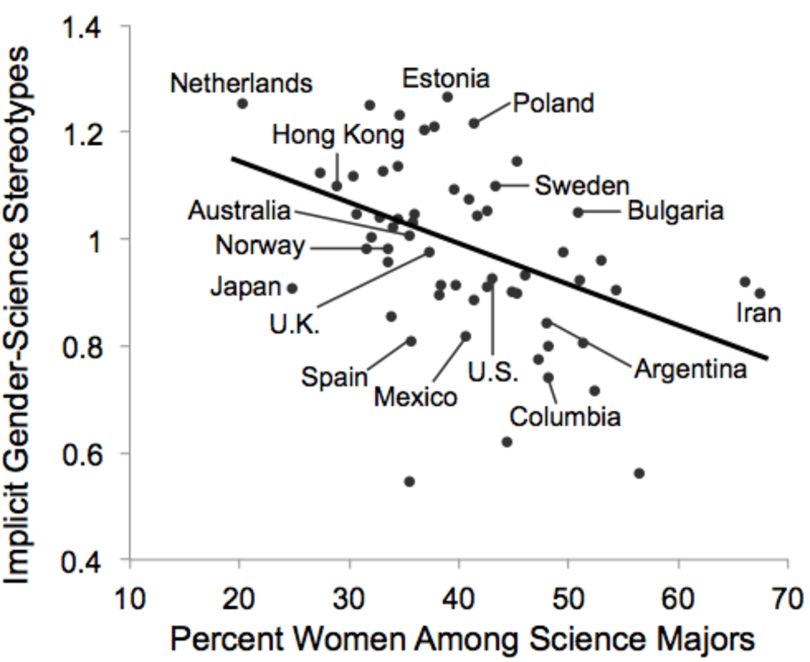
Implicit Science = Male Associations Are Stronger
in Countries with Fewer Women in Science
Canada
Miller, Eagly, & Linn, 2015
Notes:
These associations are likely connected to what children see in their culture. In this cross-national study, this tendency to ‘think science, think male’ (along the y-axis here) was significantly stronger in countries that have fewer female science majors.
So when you have fewer women going into engineering and science, these associations become even stronger, and because they become even stronger, they're likely to make it that much harder for women to get into science, creating a vicious circle.

Slide 37
Other Examples of Implicit Associations
Implicit Stereotypes
Implicit Attitudes
d’ score: Size of Association
Science = Male
Arts = Female
Math = Male
Arts = Female
Career = Male
Family = Female
Black = Bad
White = Good
Old = Bad
Young = Good
Gay = Bad
Straight = Good
Nosek, Banaji, & Greenwald, 2002; Nosek, Greenwald, & Banaji, 2005; Sriram & Greenwald, 2009
Notes:
Although we’ve been focused on implicit associations related to gender, this same type of task is often used to measure other types of implicit attitudes.
Here you can see that, on average, people associate concepts of science, math, and career more with male than with female names.
When it comes to other groups, people also have relatively strong implicit associations between their concepts of being Black, being old, or being gay with their concept of what is bad.

Slide 38
Implicit Bias =
When implicit associations
lead to unequal treatment
Can result from reflexive thinking.
Both can be unintentional, but still harmful.
Notes:
When I use the term implicit bias, what I'm talking about is what occurs when our implicit associations, that engineering/science equals male, can leak out and lead to unequal treatment.
Again, this does not need to result from conscious intentions, but can come from unintentional reflexive thinking that can still be very harmful.

Slide 39
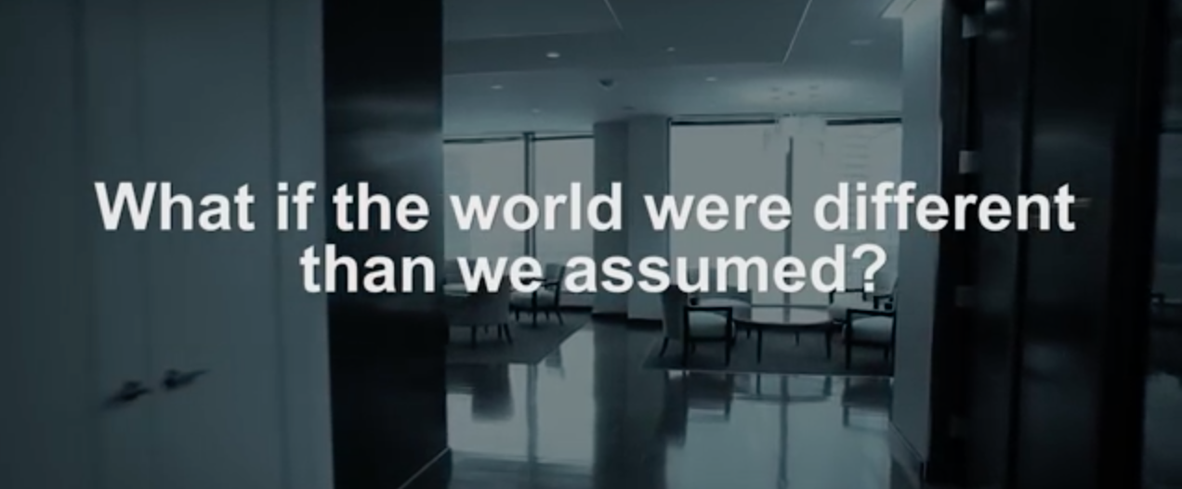


What Might Implicit Bias Look Like?
Notes:
Now that I've talked a little bit about how we have these implicit biases and how they can be measured, I want to show you some examples of what these can look like in kind of a funny way. This is a video produced by the consulting company McKinsey. It shows what things would look like if the roles were reversed and we'd actually grown up in a culture where men are the ones who are associated with these stereotypes rather than women. [play embedded video]
This video highlights what these biases might feel like by flipping the script that we're used to and imagining a world where men’s and women’s roles have been swapped. Out of curiosity, how many people in this room have heard things like this said to women? [Pause]
So, you can see just from looking around the room, that these kind of subtle implicit gender biases are quite common.
McKinsey Gender-Swap Video. Still image animated to exit, revealing “play” link for video.
Video (in Dropbox) embedded but also available via: https://youtu.be/JFW2cfzevio
Could also potentially embed as online video <iframe width="560" height="315" src="https://www.youtube.com/embed/JFW2cfzevio?rel=0" frameborder="0" allow="autoplay; encrypted-media" allowfullscreen></iframe>
Or embed downloaded video into powerpoint (likely best for workshops with unknown internet access)
[3.5 min from IAT demo to start of video]

Slide 40
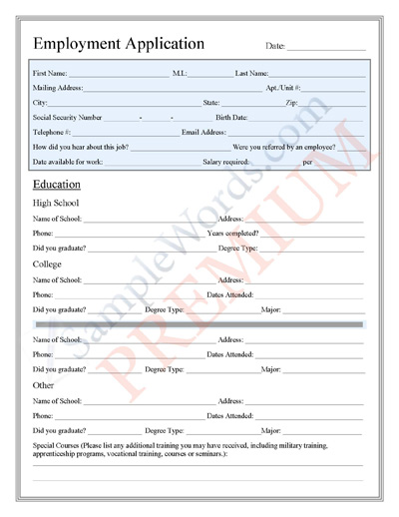
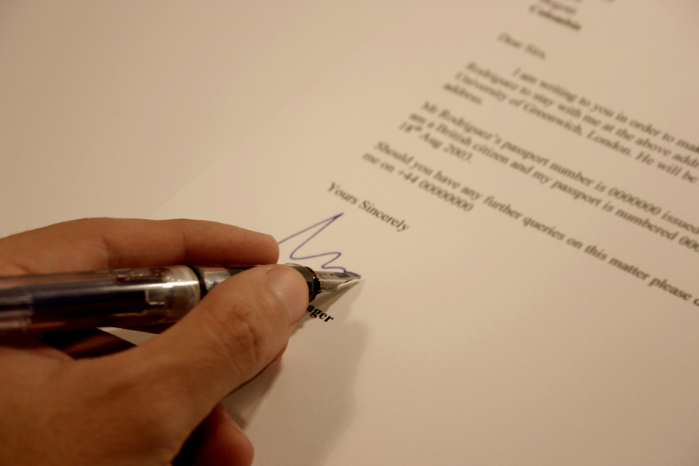
Implicit Biases in
How Women Are Perceived
Scientists rate identical applicants for a lab manager job as more competent and hirable if the applicant’s name is male (vs. female).
- Moss-Racusin et al., 2012
Recommendation letters written for male applicants often include more glowing adjectives and superlatives.
  - Dutt et al., 2016; Madera et al., 2009; Schmader et al., 2007
Both men and women show these implicit gender biases.
Notes:
But let’s look at a few of the ways that these biases can and do affect women in the real world. In one famous study, scientists were sent applications for a lab manager job.
They each got the same applications, but sometimes the name on the application was John and sometimes it was Jennifer. These objectively minded scientists rated the applicant as more competent and hireable if the name was male rather than female.
Other research has shown that letters of recommendation written for male applicants more often include glowing adjective and superlatives, even after taking into account objective qualifications of the applicants.
And consistent with the idea that all of us, can learn these culturally ingrained stereotypes, both men and women show these implicit gender biases.

Slide 41
Men and Women Higher in Implicit Bias Socialize Less with Their Female Teammates
r(648) = -.09, p = .024
  RISE Workplace Culture Survey, 2018
Notes:
In Project RISE research, they’ve shown that men and women with higher implicit biases seem to socialize less with their female teammates.
In other words, men and women who have a stronger STEM = male implicit association, measured with the implicit association test, also report that they spend less time socializing with their female teammates.
You can see how these biases might lead women in male-dominated workplaces to feel left out of informal networks at work.

Slide 42

Learning to recognize gender bias
and why it matters
Notes:
Now that you have had some time learn about implicit biases and how they are distinct from conscious intentions and stereotypes, we are going to spend some time considering some more specific examples to help us better recognize gender bias and why it matters.

Slide 43


Is this situation an example of gender bias?
Pregnancy
Promotion
Jill tells you she is irritated when her admin assistant, Alice, gets pregnant.
Alice’s husband will stay home full-time with the baby, but Jill thinks Alice’s work will suffer.
Jill’s other admin, Rob, is also a new dad, but Jill says everyone knows it’s just different with mothers.
Amy asked her boss, Mike, for a promotion and a raise.
Amy has only one year of experience and Mike has never promoted anyone with under 5 years experience.
Amy often makes mistakes and arrives late. Mike doesn’t think it makes sense to promote Amy now.
Notes:
First, lets consider two different examples.
[Read scenario 1.]
How many people think that this situation probably reflects some degree of gender bias on Jill’s part?
[read scenario 2]
How many people think that this situation reflects some degree of bias from Mike?
I’ve shown these two scenarios to underscore two points: first, women can just as easily fall prey to showing these biases. So as women, we aren’t off the hook.
Second, not every negative outcome that women receive is due to bias. Sometimes a woman really isn’t qualified for a promotion.
The trick is to become more accurate in recognizing when bias might be happening.

Slide 44


Women and men mostly agree about what is—or is not—biased
1
(Likely
not bias)
7
(Likely
bias)
Notes:
In fact, when the RISE team gave about 1000 women and men these scenarios, they mostly agreed about what is or isn't bias.
However, you’ll see that women, in orange, are the ones who actually see a greater difference between these two. Maybe because women have had more time to think about what bias is and what it isn’t.
Having an accurate idea of what bias is often means taking some time to think through these situations using that more reflective system.

Slide 45
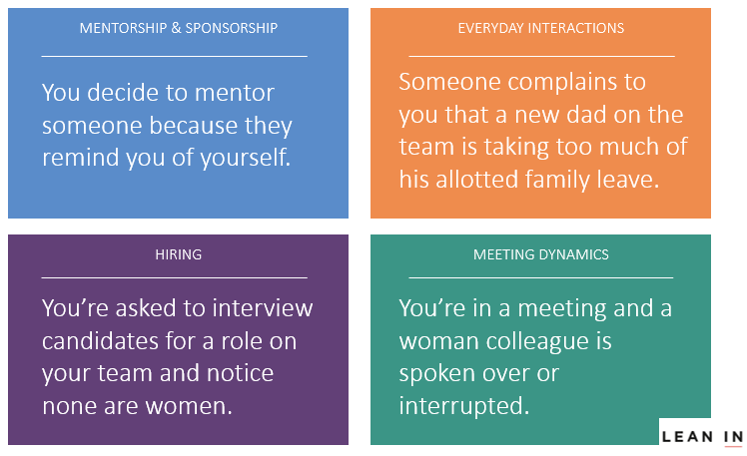
Choose a Card & Discuss at Table for 8 min.
One person reads the scenario
What role could implicit bias play in this behaviour?
What effect can this kind of bias have?
Notes:
Now I want you to spend sometime talking about one or two scenarios that are more ambiguous.
[HQP] will be coming around with a couple of cards for each table.
One person should moderate the discussion but choosing which card to start with and reading it aloud to the group.
Then at your table, spend 8 minutes talking about role implicit bias could be playing in the scenario and what kind of effect this kind of bias could have on women.
Its fine if you only discuss one, but if you have more time, you can discuss the second scenario too.
[HQP, gives each table 2 cards and they have 10 minutes to choose one and discuss it as a group.
[after time is up, ask for a few examples of the negative effects that these biases can have from the scenarios they discussed
Facilitator note: Popcorn examples of negative effect of bias from these scenarios.

Slide 46
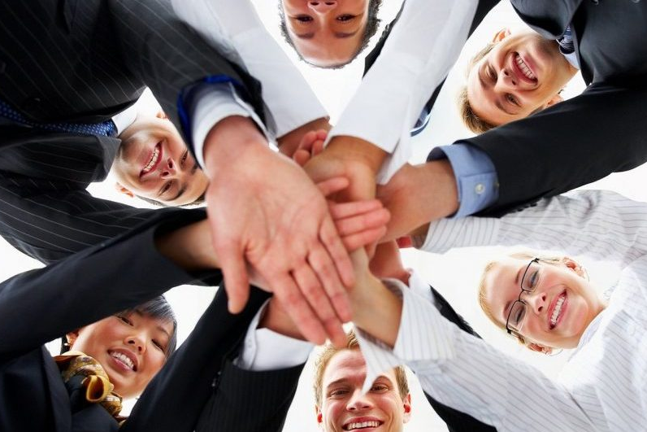


We All Thrive When We Feel a Sense of Fit
Does the field fit who I am?
Does it support my goals?
Do people there respect me?
Cheryan et al., 2009; Diekman et al., 2010; Logel et al., 2009; Schmader & Sedikides, 2018
Notes:
As you may have already guessed, implicit biases don’t just bias the way people are perceived. They also can have an effect on people’s abilities to feel a sense of fit or inclusion within their organization.
For anyone, we thrive in those places where we feel a sense of fit. We want to work in a field that fits who we are, supports our goals, and where our coworkers respect us.
The automatic tendency to associate STEM more with men than with women can potentially disrupt each of these types of fit.

Slide 47
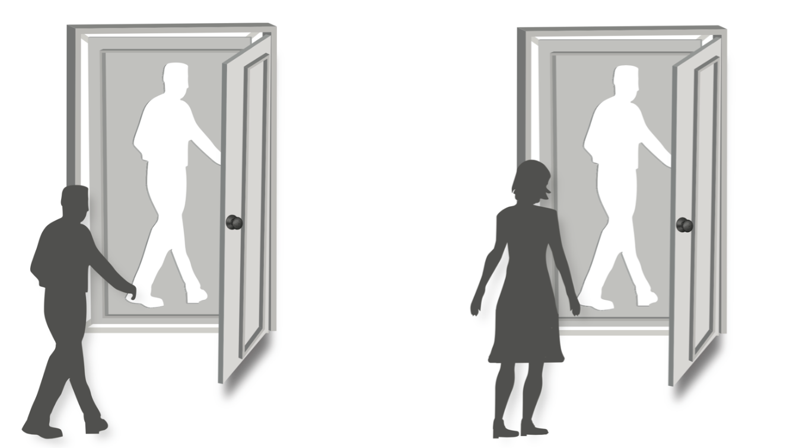
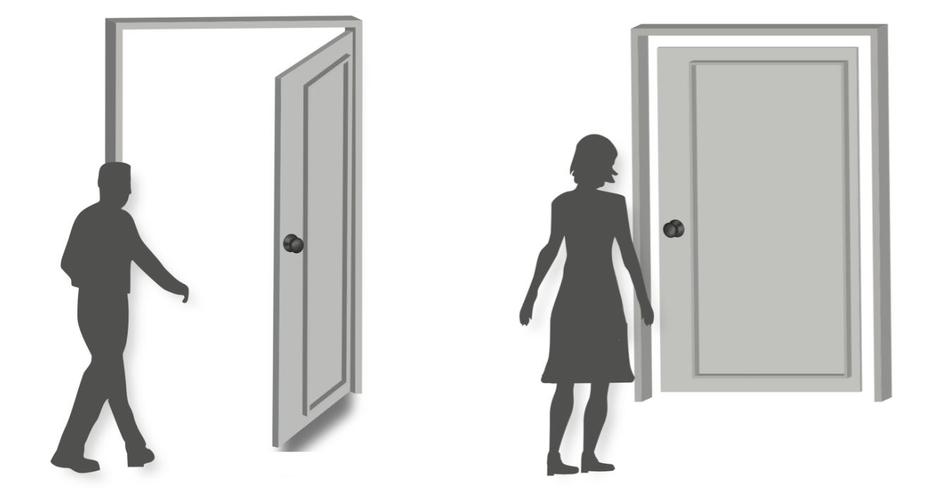
The Difference Between Diversity and Inclusion
Lack Inclusion if Subtle Bias Persists
Diversity by Ending Formal Biases
Women feel they need to fit a masculine default
Cheryan & Markus, 2019
Notes:
This insight can help us highlight the distinction between diversity and inclusion. Even if we have no formal biases and doors are equally open to men and women, automatic associations that make men the default can make women feel that they don’t belong. This is an important distinction between formal biases and subtle biases.
Formal biases involve true differential and unfair treatment where doors open to men are closed to women.
Subtle gender bias does not involve formal discrimination, but can still produce disparate access for men and women communicating that men are the default. It can be signaled in the physical environment, the policies that are in place, and in subtle treatment from others.
Let’s connect this distinction to the concepts of diversity and inclusion. As Verna Myers, an educator based in the States, said, “diversity is being invited to the party; inclusion is being asked to dance.”
So diversity means you're in the room, it means you got hired.
Inclusion means that people are asking you out to lunch, they're inviting you to consult on certain questions.
We know from other research that teams function best when there are diverse people in the room, but often only if their voices are heard and respected.

Slide 48
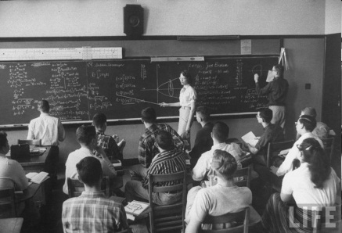
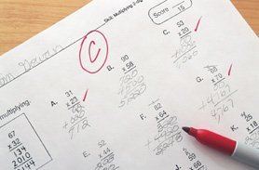
Social Identity Threat
Situations can trigger concerns that one might be evaluated on the basis of a devalued identity
Male-dominated setting
Poorer Math Performance
Social identity threat can mask a person’s true ability,
performance is enhanced in psychologically safe settings
Schmader, Johns, & Forbes, 2008; Spencer, Logel, & Davies, 2016; Steele & Aronson, 1995; Walton & Spencer, 2009
Notes:
Now these subtle reminders of gender and gender stereotypes can trigger concerns that one might be evaluated on the basis of the devalued identity, this is called social identity threat.
Research suggests that situations that remind people of their gender, or their race, or their age, or their sexual orientation, of some kind of devalued identity, especially if there’s a negative stereotype—a performance stereotype—attached to it, can actually lead to poor performance.
For example, women made highly aware of gender stereotypes that women aren't supposed to be as good at math sometimes perform more poorly on a difficult math test. And importantly, if these stereotypes aren't brought to mind, women often perform just as just as well as men.
So, what this means is that social identity threat can actually hide or mask a person’s true ability. Everyone’s performance can be enhanced if we’re working in more inclusive and psychologically safe settings.
Work on transition to meritocracy point 1

Slide 49
The Paradox of Meritocracy
“But shouldn’t we just hire the best person?”
Efforts to increase representation is not at odds with merit when biases exist
Evaluations are not completely objective
A focus on ‘rewarding the best’ can lead to greater bias
Castilla, 2008; Castilla & Benard, 2010; Crosby et al., 2003; Uhlmann & Cohen, 2007
Notes:
In discussions about efforts toward increasing the representation of some underrepresented group, people will sometimes ask, “but shouldn’t we just hire the best person?” Let’s talk about three answers to this question:
First, Efforts to increase representation are not at odds with merit if biases exist. Because social identity threat can mask true ability, those who experience these threats the most might have greater potential than so-called objective indicators might suggest.
Second, evaluations are not completely objective. People are naturally attracted to candidates who are similar to themselves. And we do an extraordinarily good job of justifying that opinion. For example, we might selectively weight aspects of the application that support the person they want to hire convincing even themselves that they have made an entirely rational opinion.
Perhaps most importantly, people trying to be merit-based can end up being biased. This is called the paradox of meritocracy.

Slide 50
The Paradox of Meritocracy
“But shouldn’t we just hire the best person?”
Castilla, 2008; Castilla & Benard, 2010; Crosby et al., 2003; Uhlmann & Cohen, 2007
Notes:
& In this study, managers were asked to review a set of matched profiles with equally strong qualifications and assign yearly bonuses.
In one condition, people were just given information about the value of having regular performance evaluations. When people were given this basic description, there was no difference in the bonuses they offered to the male and the female candidate.
In the other condition, the instructions emphasized that these evaluations were a way to reward those who show the best performance. Even though they were rating a male and female employee who were matched on objective indicators, when the idea of rewarding based on merit was emphasized, they recommended a significantly larger financial bonus to the man than to the woman.
Sometimes an exclusive focus on meritocracy actually maximizes the chance of bias, which suggests that our idea of excellence brings to mind a male default. What may be organizational accepted as “the best” performance or skill is often the “male-default” that is socially accepted.
Castill & Benard (2001)
101 Bschool Students
Performance Evaluation:
All employees are to be evaluated annually
Performance evaluations include quantitative and qualitative information
Performance evaluations are part of official personnel file
Performance evaluations are discussed with employee
Meritocratic Reward
All employees are to be rewarded fairly
Raises are determined entirely on performance
Bonuses only for those whose performance shows they deserve it
Reward all employees equitably every year

Slide 51
Benefits of Working in a
Gender-Inclusive Culture
  RISE Workplace Culture Survey, 2018
Notes:
A final point to make before we close the first half of the workshop, is to share a bit more data from research on the value of working for an organization with a gender inclusive culture. As part of their research, the Project RISE team asked STEM professionals to rate the degree to which their company has gender inclusive policies and practices in place. In those companies where people report a more gender inclusive culture, women experience much less social identity threat. They are simply less aware of their gender on a day-to-day basis.
Furthermore, both men and women report higher commitment to the organization to the degree that the culture is more supportive of gender inclusion. Although inclusion can particularly create a more welcoming environment for women, it also seen as benefiting everyone.

Slide 52
We all value innovative problem-solving
Diverse teams can be more highly innovative
Implicit biases can get in the way
These biases are distinct from conscious motivations
Biases can affect how women are perceived
Biases can undermine women’s own feelings of fit
Notes:
To sum up, diversity on our teams can foster innovation. But the implicit biases that I've talked about can get in the way.
Now these biases are distinct from out conscious motivations, but they can still affect how women are perceived.
They can also undermine women’s own feelings of fit, which are important determinants of workplace engagement.
I’ll pause here briefly for questions, and then we're going to talk about what can we do to work together on this issue.

Slide 53


